Slide 1
Intel processors and platforms roadmap for energy efficient HPC solutions
Andrey Semin
Principal Engineer
HPC Technology Manager, EMEA
Moscow, 3rd July 2015

Slide 2
Notices
This slide MUST be used with any slides with performance data removed from this presentation
INFORMATION IN THIS DOCUMENT IS PROVIDED IN CONNECTION WITH INTEL PRODUCTS. NO LICENSE, EXPRESS OR IMPLIED, BY ESTOPPEL OR OTHERWISE, TO ANY INTELLECTUAL PROPERTY RIGHTS IS GRANTED BY THIS DOCUMENT. EXCEPT AS PROVIDED IN INTEL'S TERMS AND CONDITIONS OF SALE FOR SUCH PRODUCTS, INTEL ASSUMES NO LIABILITY WHATSOEVER AND INTEL DISCLAIMS ANY EXPRESS OR IMPLIED WARRANTY, RELATING TO SALE AND/OR USE OF INTEL PRODUCTS INCLUDING LIABILITY OR WARRANTIES RELATING TO FITNESS FOR A PARTICULAR PURPOSE, MERCHANTABILITY, OR INFRINGEMENT OF ANY PATENT, COPYRIGHT OR OTHER INTELLECTUAL PROPERTY RIGHT.
UNLESS OTHERWISE AGREED IN WRITING BY INTEL, THE INTEL PRODUCTS ARE NOT DESIGNED NOR INTENDED FOR ANY APPLICATION IN WHICH THE FAILURE OF THE INTEL PRODUCT COULD CREATE A SITUATION WHERE PERSONAL INJURY OR DEATH MAY OCCUR.
Intel may make changes to specifications and product descriptions at any time, without notice. Designers must not rely on the absence or characteristics of any features or instructions marked "reserved" or "undefined." Intel reserves these for future definition and shall have no responsibility whatsoever for conflicts or incompatibilities arising from future changes to them. The information here is subject to change without notice. Do not finalize a design with this information.
The products described in this document may contain design defects or errors known as errata which may cause the product to deviate from published specifications. Current characterized errata are available on request.
This document contains information on products in the design phase of development.
All products, computer systems, dates, and figures specified are preliminary based on current expectations, and are subject to change without notice.
Intel product plans in this presentation do not constitute Intel plan of record product roadmaps. Please contact your Intel representative to obtain Intel’s current plan of record product roadmaps.
Software and workloads used in performance tests may have been optimized for performance only on Intel microprocessors. Performance tests, such as STREAM , NPB, NAMD and Linpack, are measured using specific computer systems, components, software, operations and functions. Any change to any of those factors may cause the results to vary. You should consult other information and performance tests to assist you in fully evaluating your contemplated purchases, including the performance of that product when combined with other products.
Intel does not control or audit the design or implementation of third party benchmarks or Web sites referenced in this document. Intel encourages all of its customers to visit the referenced Web sites or others where similar performance benchmarks are reported and confirm whether the referenced benchmarks are accurate and reflect performance of systems available for purchase.
Relative performance is calculated by assigning a baseline value of 1.0 to one benchmark result, and then dividing the actual benchmark result for the baseline platform into each of the specific benchmark results of each of the other platforms, and assigning them a relative performance number that correlates with the performance improvements reported.
Intel, Xeon and the Intel logo are trademarks of Intel Corporation in the U.S. and other countries.
*Other names and brands may be claimed as the property of others
Copyright © 2015 Intel Corporation. All rights reserved.

Slide 3
Risk Factors
This slide MUST be used with any slides with performance data removed from this presentation
The above statements and any others in this document that refer to plans and expectations for the third quarter, the year and the future are forward-looking statements that involve a number of risks and uncertainties. Words such as “anticipates,” “expects,” “intends,” “plans,” “believes,” “seeks,” “estimates,” “may,” “will,” “should” and their variations identify forward-looking statements. Statements that refer to or are based on projections, uncertain events or assumptions also identify forward-looking statements. Many factors could affect Intel’s actual results, and variances from Intel’s current expectations regarding such factors could cause actual results to differ materially from those expressed in these forward-looking statements. Intel presently considers the following to be the important factors that could cause actual results to differ materially from the company’s expectations. Demand could be different from Intel's expectations due to factors including changes in business and economic conditions; customer acceptance of Intel’s and competitors’ products; supply constraints and other disruptions affecting customers; changes in customer order patterns including order cancellations; and changes in the level of inventory at customers. Uncertainty in global economic and financial conditions poses a risk that consumers and businesses may defer purchases in response to negative financial events, which could negatively affect product demand and other related matters. Intel operates in intensely competitive industries that are characterized by a high percentage of costs that are fixed or difficult to reduce in the short term and product demand that is highly variable and difficult to forecast. Revenue and the gross margin percentage are affected by the timing of Intel product introductions and the demand for and market acceptance of Intel's products; actions taken by Intel's competitors, including product offerings and introductions, marketing programs and pricing pressures and Intel’s response to such actions; and Intel’s ability to respond quickly to technological developments and to incorporate new features into its products. The gross margin percentage could vary significantly from expectations based on capacity utilization; variations in inventory valuation, including variations related to the timing of qualifying products for sale; changes in revenue levels; segment product mix; the timing and execution of the manufacturing ramp and associated costs; start-up costs; excess or obsolete inventory; changes in unit costs; defects or disruptions in the supply of materials or resources; product manufacturing quality/yields; and impairments of long-lived assets, including manufacturing, assembly/test and intangible assets. Intel's results could be affected by adverse economic, social, political and physical/infrastructure conditions in countries where Intel, its customers or its suppliers operate, including military conflict and other security risks, natural disasters, infrastructure disruptions, health concerns and fluctuations in currency exchange rates. Expenses, particularly certain marketing and compensation expenses, as well as restructuring and asset impairment charges, vary depending on the level of demand for Intel's products and the level of revenue and profits. Intel’s results could be affected by the timing of closing of acquisitions and divestitures. Intel's results could be affected by adverse effects associated with product defects and errata (deviations from published specifications), and by litigation or regulatory matters involving intellectual property, stockholder, consumer, antitrust, disclosure and other issues, such as the litigation and regulatory matters described in Intel's SEC reports. An unfavorable ruling could include monetary damages or an injunction prohibiting Intel from manufacturing or selling one or more products, precluding particular business practices, impacting Intel’s ability to design its products, or requiring other remedies such as compulsory licensing of intellectual property. A detailed discussion of these and other factors that could affect Intel’s results is included in Intel’s SEC filings, including the company’s most recent reports on Form 10-Q, Form 10-K and earnings release.
Rev. 7/17/13
Optimization Notice
Intel's compilers may or may not optimize to the same degree for non-Intel microprocessors for optimizations that are not unique to Intel microprocessors. These optimizations include SSE2, SSE3, and SSE3 instruction sets and other optimizations. Intel does not guarantee the availability, functionality, or effectiveness of any optimization on microprocessors not manufactured by Intel. Microprocessor-dependent optimizations in this product are intended for use with Intel microprocessors. Certain optimizations not specific to Intel microarchitecture are reserved for Intel microprocessors. Please refer to the applicable product User and Reference Guides for more information regarding the specific instruction sets covered by this notice. Notice revision #20110804

Slide 4

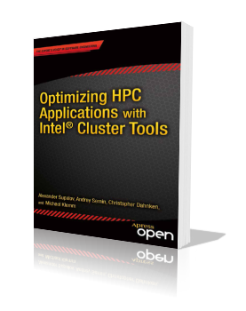
Meet the book of the year… :)
Authors: Alexander Supalov, Andrey Semin, Michael Klemm, Chris Dahnken
Table of Contents:
Foreword by Bronis de Supinski (CTO LLNL)
Preface
Chapter 1: No Time to Read this Book?
Chapter 2: Overview of Platform Architectures
Chapter 3: Top-Down Software Optimization
Chapter 4: Addressing System Bottlenecks
Chapter 5: Addressing Application Bottlenecks: Distributed Memory
Chapter 6: Addressing Application Bottlenecks: Shared Memory
Chapter 7: Addressing Microarchitecture Bottlenecks
Chapter 8: Application Design Implications
ISBN-13 (pbk): 978-1-4302-6496-5
ISBN-13 (electronic): 978-1-4302-6497-2
Order now at http://clusterbook.info
or download free eBook edition from Amazon (Kindle), Google Books, etc.
Notes:
http://www.apress.com/9781430264965

Slide 5
Agenda
HPC Trends
  Process Improvement
  Cores & Threads
  Power Efficiency
  Integration to increase system performance
Multi- and Many-core development directions
I must need a huge datacenter –right?

Slide 6

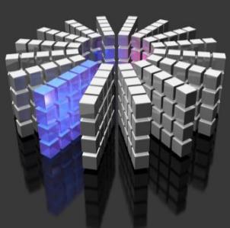

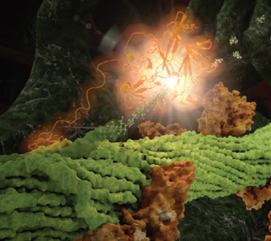
The Path to Discovery & Innovation
TECH COMPUTING / HPC
Numerical Simulation Big Data Analytics Visualization

Slide 7
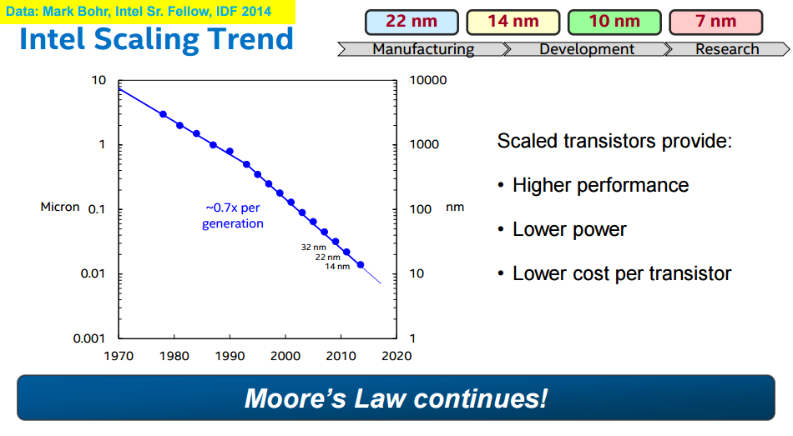

Slide 8







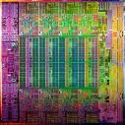


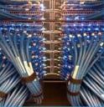

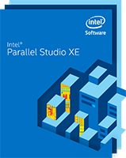
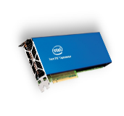
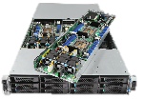
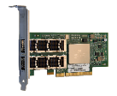
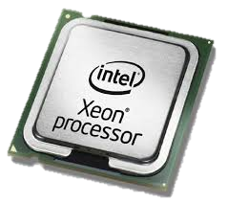
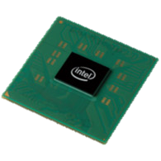
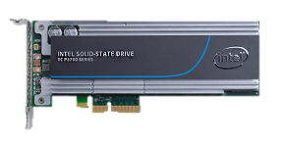


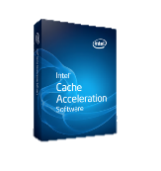

Intel Technical Computing & HPC
Solutions Portfolio
Compute
Processing
Systems
& Boards
Network
& Fabric
I/O & Storage
Software
& Services
2015
Intel®
Cluster
Ready

Slide 9




Increasing Processor Performance
Through Many-Core Technologies for Highly Parallel Workloads
FLOPS/processor
Many-Core
TFLOPS
Tera-Scale R&D
Performance
Multi-Core
Pentium® 4 Architecture
Pentium® III Architecture
Intel® Core™ uArch
Pentium® II Architecture
Pentium® Architecture
486
386
Future options subject to change without notice. Source: Intel
Time
estimated
For illustration only, not drawn to scale. All dates, product descriptions, features, availability, and plans are forecasts and subject to change without notice.

Slide 10
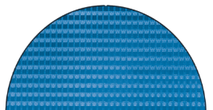
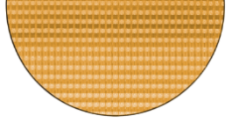
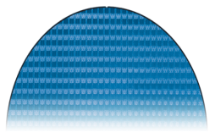

IA Cores build on a Common Architecture
Scalable Performance
Energy Efficient
Microarchitecture
45nm
32nm
22nm
14nm
Nehalem
Sandy Bridge
Haswell
Highly Parallel
Energy Efficient
Architecture
Knights
Ferry
Knights
Corner
Knights
Landing
All dates, product descriptions, availability, and plans are forecasts and subject to change without notice.

Slide 11
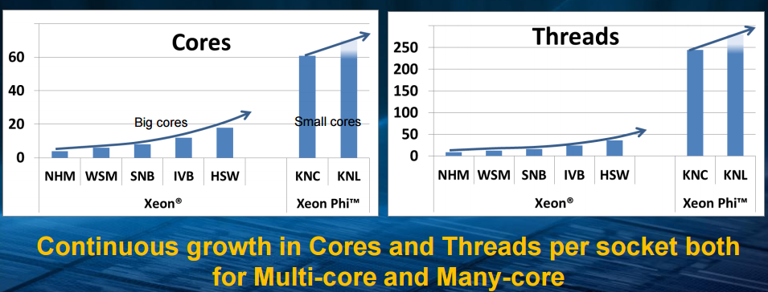
Trends: Cores and Threads per Chip
Source: SICS Multicore Day’ 14

Slide 12
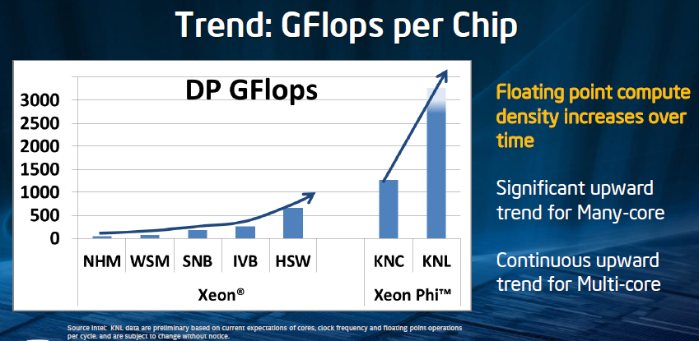
Source: SICS Multicore Day’ 14

Slide 13
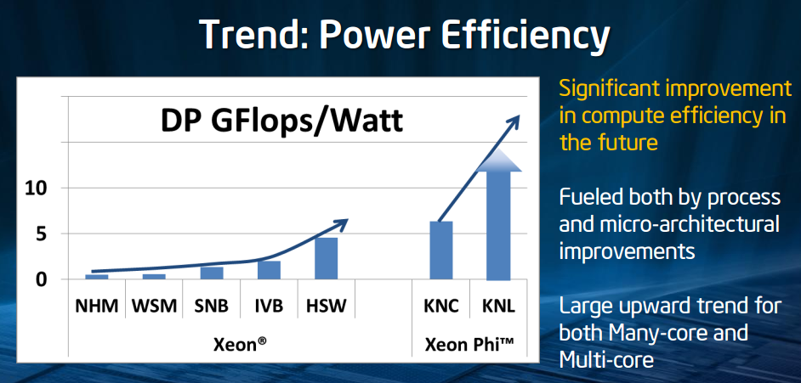
Source: SICS Multicore Day’ 14

Slide 14
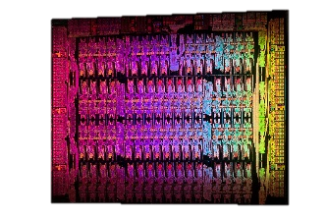
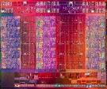
„Big Core“ – „Small Core“
Different Optimization Points
Common Programming Models
and Architectural Elements
Intel® Xeon® Processor |  | Intel® Xeon Phi™ Coprocessor
Simply aggregating more cores generation after generation is not sufficient |  | Optimized for highest compute per watt
Performance per core/thread must increase each generation, be as fast as possible |  | Willing to trade performance per core/thread for aggregate performance
Power envelopes should stay flat or go down each generation |  | Power envelopes should also stay flat or go down every generation
Balanced platform (Memory, I/O, Compute) |  | Optimized for highly parallel workloads
Cores, Threads, Caches, SIMD |  | Cores, Threads, Caches, SIMD
For illustration only

Slide 15
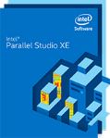
Portable & Scalable Parallel Programming
Data-Parallelism
Thread/Task-Parallelism
Process-Parallelism
Vectorization
Automatic
Directives/Pragmas
Libraries
Multi-Threading
OpenMP*
TBB, Cilk™ Plus
OpenCL
pthreads
Message Passing
MPI
IP-based
2015
2015
2015
Professional Edition
Professional Edition
Cluster Edition
Node
128b
SIMD
. . .
256b
512b
Multicore
Many-Core
Cluster

Slide 16
SIMD Floating-Point Performance (Peak) per Core/Cycle
AVX-512
Knights Landing/
Future Xeon
512-bit
FMA (*,+)
AVX2
Haswell
256-bit
FMA (*,+)
AVX
Sandy Bridge
256-bit
MUL (*)
ADD (+)
All dates, product descriptions, features, availability, and plans are forecasts and subject to change without notice.

Slide 17
Intel AVX Family of Instruction Set Extentions
AVX (SNB/IVB) | AVX2 (HSW/BDW)
256-bit basic FP 16 registers NDS (and AVX128) Improved blend MASKMOV Implicit unaligned | 256-bit integer PERMD Gather Float16 (IVB 2012) 256-bit FP FMA
AVX-512
512-bit FP and Integer 32 registers 8 mask registers Embedded rounding Embedded broadcast Scalar/SSE/AVX “promotions” Native media additions HPC additions Transcendental support Gather/Scatter
Notes:
Some (3) instructions on KNL not in SKL, e.g. Recip (= TVX???)
Some instructions on SKL not in KNL e.g. 512b for 8b, 16b

Slide 18
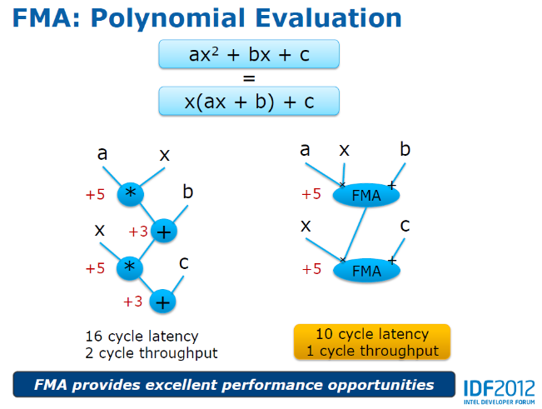
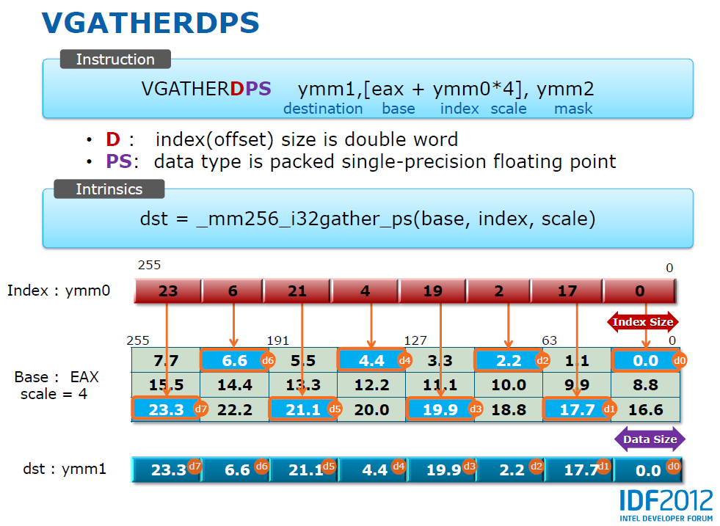
AXV2 Highlights
FMA Instruction
GATHER Instruction

Slide 19
Haswell Core at a Glance
Branch Prediction
Icache
Tag
ITLB
µop Cache
Tag
Improved Front-end
  Branch Prediction improves performance & saves wasted work
  Initiate TLB & cache misses speculatively
  Cache missies handled in parallel to hide latency
More execution units with shorter latencies
  4th ALU & 2nd branch execution unit
More load/store bandwidth
  Better prefetching, better cache line split latency & throughput, double L2 bandwidth
No pipeline growth vs. Ivy Bridge
  Same branch misprediction latency
  Same L1/L2 cache latency
Icache Data
µop Cache
Data
Decode
Decode
uop
Queue
µop Allocation
Unified Reservation Station (OoO)
0
1
2
3
4
5
6
7

Slide 20
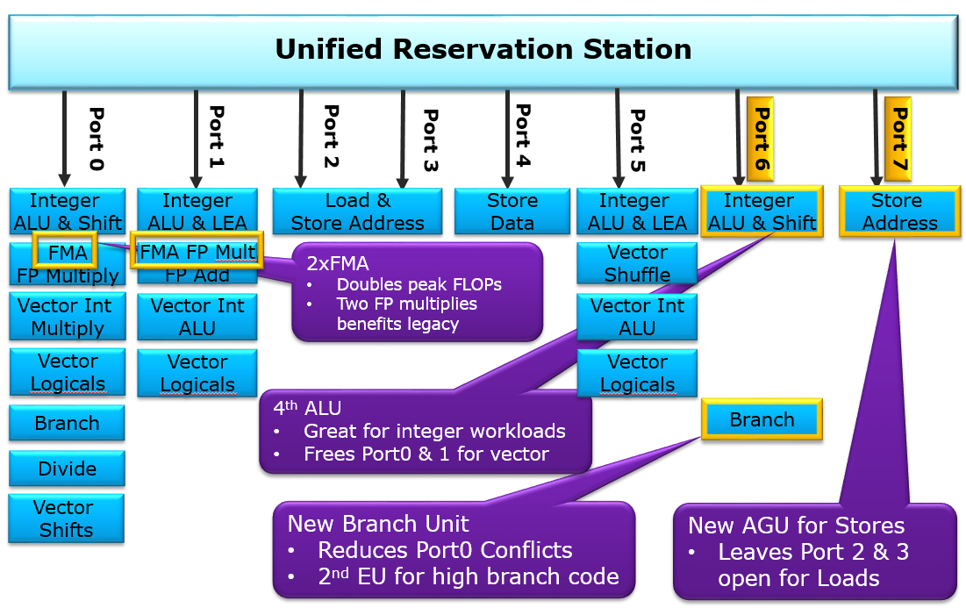
Haswell Execution Units Overview

Slide 21
Major Buffer Sizes
 | Nehalem | Sandy Bridge | Haswell
Out-of-order Window | 128 | 168 | 192
In-flight Loads | 48 | 64 | 72
In-flight Stores | 32 | 36 | 42
Scheduler Entries | 36 | 54 | 60
Integer Register File | N/A | 160 | 168
FP Register File | N/A | 144 | 168
Allocation Queue | 28/thread | 28/thread | 56

Slide 22

Intel® Xeon® Processors and Platforms
Intel® Xeon® E3
Intel® Xeon® E5
Intel® Xeon® E7
E5
E7
Memory
E3
Memory
2x QPI
Memory
3x QPI
PCIe3
PCIe3
PCIe3
Intel® Xeon®
E5-1xxx
Intel® Xeon®
E5-2xxx
Intel® Xeon®
E5-4xxx
Intel® Xeon®
E7-xxxx
Intel® Xeon®
E7-xxxx
CPU/Socket
QPI
Intel® Xeon®
E3-1xxx
Future options are forecasts and subject to change without notice.
OEM
Node Controller

Slide 23
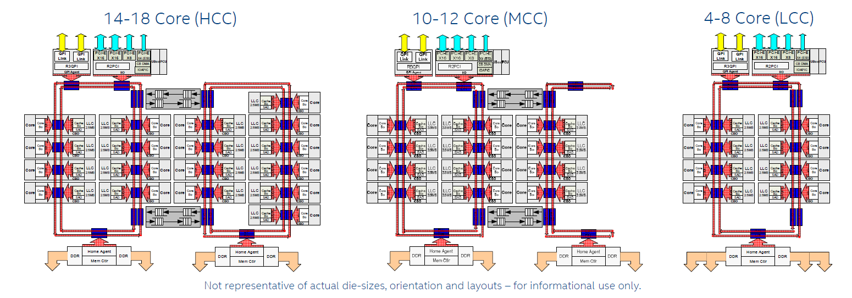
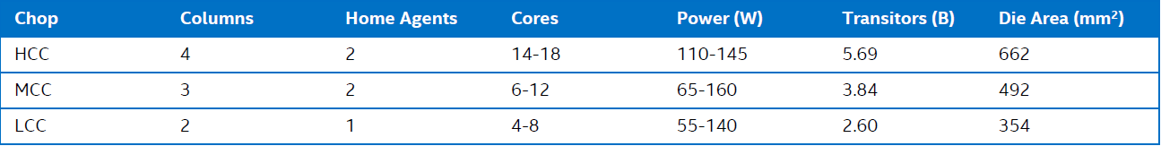
Haswell-EP (Xeon E5-2600 v3) Die Options
Notes:
Illustration of the High Core Count (HCC), Medium Core Count (MCC) and Low Core Count processors from which all of the family is derived.
Key take-away: 2 memory controllers on HCC & LCC dies – enables higher memory bandwidth & support of Cluster on Die snoop mode (new to HSW)
14C HCC consists of 4 columns and 2 Memory Controllers with buffered switch boxes (Sbo) that allow for cross ring traffic
12C MCC consists of 3 columns 4 (core + LLC slices) and 2 Memory Controllers with the ½ ring still running at full bi-directional speeds
8C LCC consists of 2 columns 4 (core + LLC slices) using a single ring and single Memory Controller

Slide 24
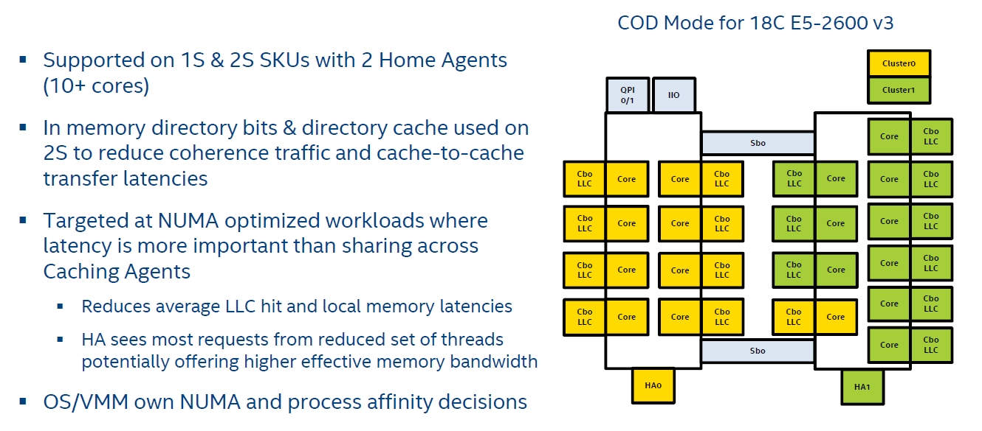
New Cluster On Die (COD) Snoop Mode

Slide 25
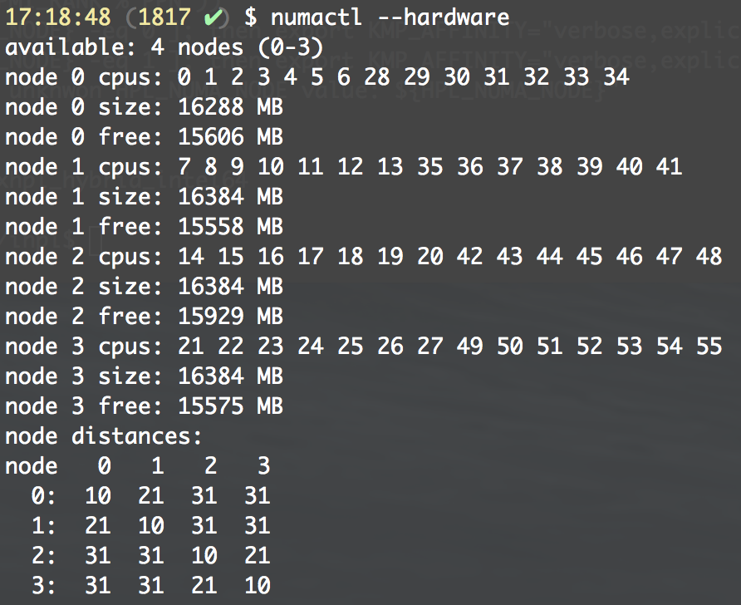
Cluster on Die (COD) Mode
COD Mode for 14C HSW-EP
Cluster0
COD Mode for 12C HSW-EP
IIO
Cluster1
QPI 0/1
Sbo
QPI 0/1
IIO
Core
Cbo
LLC
Cbo
LLC
Core
Sbo
Cbo
LLC
Core
Core
Cbo
LLC
Cbo
LLC
Core
Cbo
LLC
Core
Core
Cbo
LLC
Cbo
LLC
Core
Core
Cbo
LLC
Cbo
LLC
Core
Core
Cbo
LLC
Cbo
LLC
Core
Cbo
LLC
Core
Core
Cbo
LLC
Cbo
LLC
Core
Core
Cbo
LLC
Cbo
LLC
Core
Core
Cbo
LLC
Cbo
LLC
Core
Cbo
LLC
Core
Core
Cbo
LLC
Cbo
LLC
Core
Core
Cbo
LLC
Cbo
LLC
Core
Core
Cbo
LLC
Cbo
LLC
Core
Sbo
Sbo
HA0
HA1
HA0
HA1
When CoD is enabled in BIOS, the dual-socket system will be present to the OS as having 4 NUMA nodes
Memory will be equally distributed between NUMA nodes
Example with dual E5-2697 v3 (2.6GHz, 14 cores, HT enabled) and 64GB of RAM

Slide 26
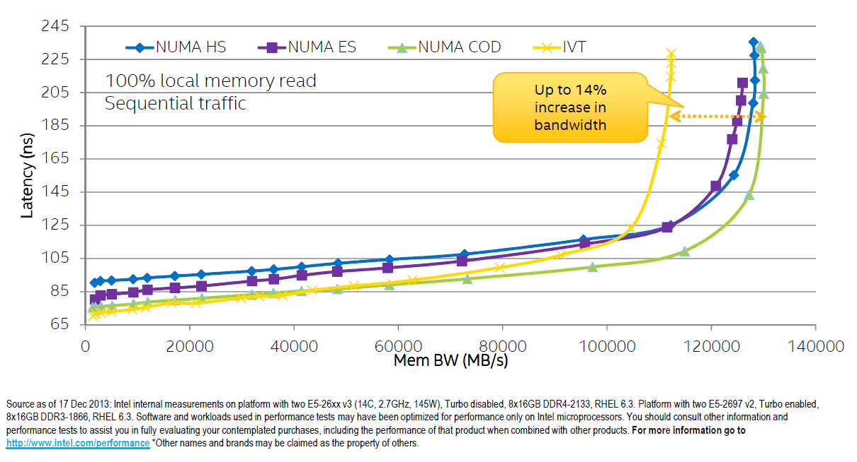
HSW-EP Memory Read & Latency Bandwidth

Slide 27
Intel® Xeon® Processor E5-2600 v3 Product Family
High Performance Computing Summary
Up to 1.72x Geomean
Up to 1.39x Geomean
Up to 1.24x Geomean
Up to 1.25x Geomean
Up to 1.32x Geomean
Dynamic Analysis | FEA | Crash Simulation | CFD | Multiphysics Sim
SEIS-kernel2 | SEIS-kernel3
FNR | BlackScholes⁺⁺ | binomialcpu⁺⁺ | MonteCarlo⁺⁺
MILC⁺⁺ | Amber | Gaussian | Gromacs+ | Gamess | Bowtie2++ | Blast | NAMD⁺⁺
WRF⁺ | ROMS⁺ | HOMME⁺
⁺Optimized for AVX. ⁺⁺Optimized for AVX2. Source as of June 2014: Intel internal measurements on platform with two E5-2697 v2, 8x8GB DDR3-1866, RHEL6.3. Platform with two E5-2699 v3, 8x8GB DDR4-2133, RHEL 6.3, NUMA-COD mode for all except Energy- ES mode. Software and workloads used in performance tests may have been optimized for performance only on Intel microprocessors. Performance tests, such as SYSmark and MobileMark, are measured using specific computer systems, components, software, operations and functions. Any change to any of those factors may cause the results to vary. You should consult other information and performance tests to assist you in fully evaluating your contemplated purchases, including the performance of that product when combined with other products. For more information go to http://www.intel.com/performance *Other names and brands may be claimed as the property of others.
Intel Confidential
Notes:
Computer Aided Engineering Applications (left -> right):
Static, Low Speed Dynamic Analysis
Non-Linear Transiet Finite Element Analysis (FEA)
Crash Simulation
Computational Fluid Dyanmics (CFD)
Multiphysics Simulation
Measurements will also be available on E5-2699 v3, E5-2698 v3, E5-2690 v3, E5-2667 v3
- Workloads optimized for AVX:
-All Numerical Weather
-Life Sciences: Gromacs
- Workloads optimized for AVX2:
-Financial Services: all except FNR
-Life Sciences: all except Blast, Gamess, Gaussian;

Slide 28
History: Software
How old is HPC software?
Code | Area | Date
NASTRAN | Structures | 1968
Spice | E-Cad | 1972
Pam-Crash | Structures | 1978
UKMO Unified Model | Weather | 1990
PETSc | Solvers | 1991
LAPACK | Solvers | 1992
NWCHEM | Chemistry | 1995
WRF | Weather | 2000
Code lasts much longer than hardware
We must support old code on new hardware
Notes:
Dates are as close to release 1.0 as I can find. Sources below
http://en.wikipedia.org/wiki/LAPACK
http://onlinelibrary.wiley.com/doi/10.1002/qua.560560851/abstract
http://en.wikipedia.org/wiki/Pam-Crash
http://www.metoffice.gov.uk/research/modelling-systems/unified-model
http://www.mmm.ucar.edu/mm5/mpp/ecmwf01.htm
http://www.mcs.anl.gov/petsc/documentation/tutorials/Speedup10.pdf

Slide 29
History: Software
How old are languages?
Language | Date
Fortran | 1966 (FORTRAN 66)
C | 1978 (K&R)
C++ | 1985 (C++ Programming Language)
MPI | 1994
OpenMP | 1997
Languages that work have a long life
  Investment in code
  Investment in brain-cells
All have open specifications & many implementations
  Formal standards (C, C++, Fortran)
  Open industry standards (MPI, OpenMP)
We must support old languages on new hardware
Notes:
Dates are of first widely accepted standard. The first Fortran compiler was available in 1957…
Of course languages and libraries evolve, but old code continues to run, and investment in brain-cells is preserved.
Yes, I know MPI isn’t a language, but it’s close…

Slide 30


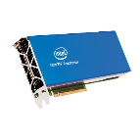

Intel® Xeon Phi™ Product Family
Based on Intel® Many Integrated Core (MIC) Architecture
Future
Knights Hill
Next generation of
the Intel® MIC Architecture Product Line
Knights Landing
with Fabric
Knights Landing
2016
Knights Landing
Intel® Xeon Phi™
x200 Product Family
2013
Knights Corner
Intel® Xeon Phi™
x100 Product Family
10 nm process
2nd Generation
Integrated Intel®
Omni-Path
… In planning …
14 nm process
Processor & Coprocessor
Over 3 TF DP Peak
Up to 72 Cores
On Package High-Bandwidth Memory
3X Single-Thread
Out-of-order core
22 nm process
Coprocessor
Over 1 TF DP Peak
Up to 61 Cores
Up to 16GB GDDR5
*Per Intel’s announced products or planning process for future products

Slide 31
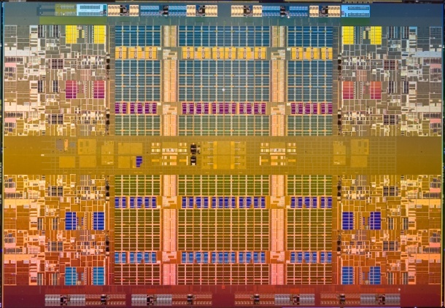
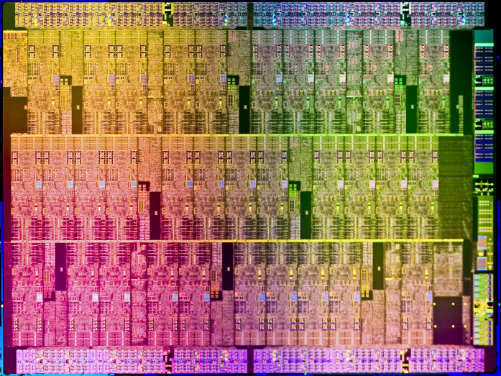
Spectrum of Programming Models
Xeon®-Centric MIC-Centric
Xeon-hosted Offload Symmetric MIC-hosted
General purpose serial and parallel computing
Codes with balanced needs
Highly parallel codes
Codes with highly parallel phases
Main( )
Foo( )
MPI_*()
Main( )
Foo( )
MPI_*()
Main( )
Foo( )
MPI_*()
Xeon
Foo( )
Main( )
Foo( )
MPI_*()
Main()
Foo( )
MPI_*()
MIC
All products, computer systems, dates, and figures specified are preliminary based on current expectations, and are subject to change without notice.

Slide 32
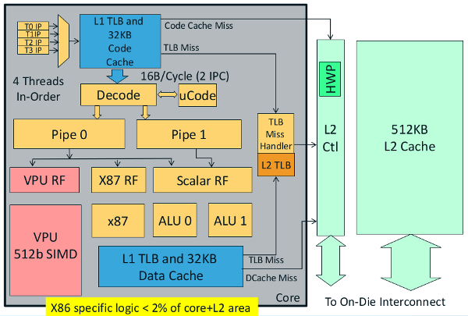
Knights Corner Core Architecture

Slide 33
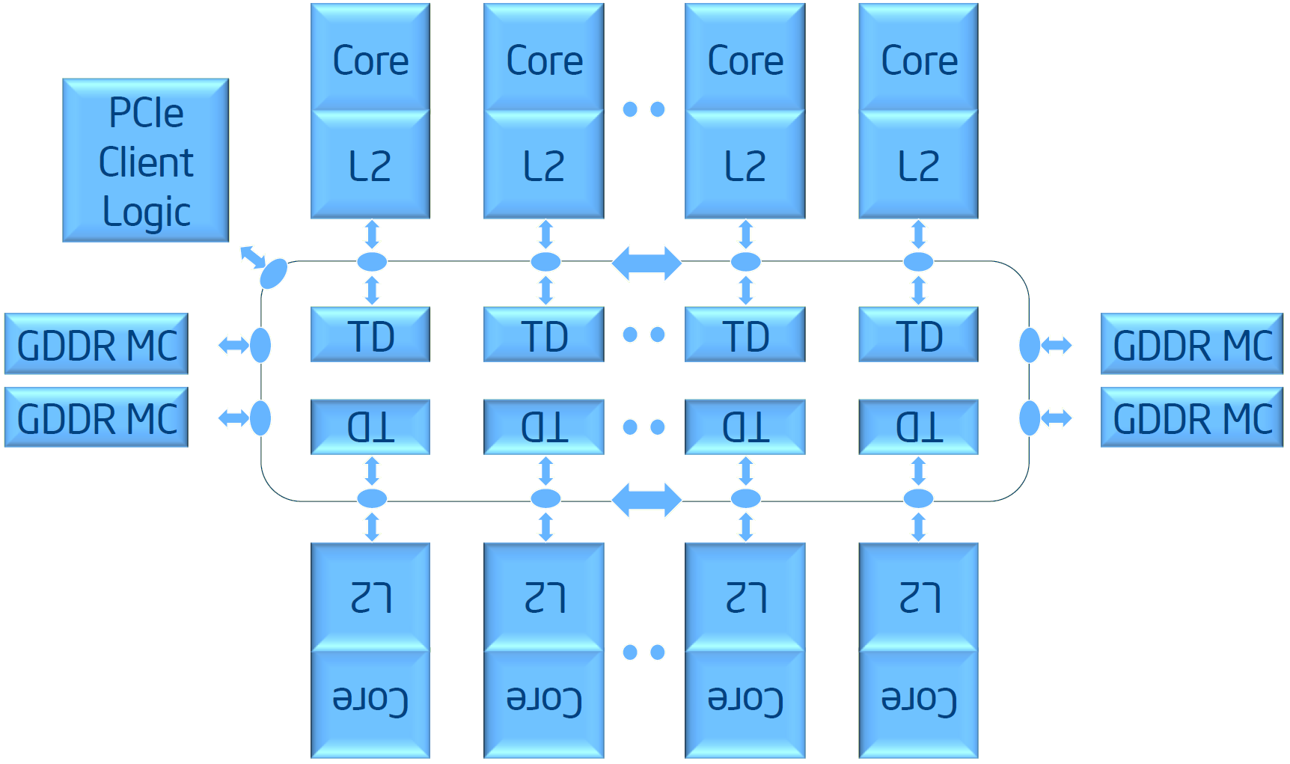
Knights Corner Microarchitecture
Tag Directories track cache-lines in all L2s
…
TAG
Core Valid Mask
State
TAG
Core Valid Mask
State
TD
BL: 64 bytes Data
AD: Command and address
AK: Coherence and Credits
AK: Coherence and Credits
AD: Command and address
BL: 64 bytes Data
Standard IA Shared Memory Programming
Notes:
Ref: http://semiaccurate.com/2012/08/28/intel-details-knights-corner-architecture-at-long-last/

Slide 34
Application Performance
Intel® Xeon Phi™ Coprocessor vs. 2 socket Intel® Xeon® processor
DCC
Energy
Financial Services
Life Sciences
Mfg.
Physics
Weather
Higher is Better
Software and workloads used in performance tests may have been optimized for performance only on Intel microprocessors. Performance tests, such as SYSmark and MobileMark, are measured using specific computer systems, components, software, operations and functions. Any change to any of those factors may cause the results to vary. You should consult other information and performance tests to assist you in fully evaluating your contemplated purchases, including the performance of that product when combined with other products.
Source: Intel measured as of Q1 2015 Configuration Details: Please slide speaker notes. For more information go to http://www.intel.com/performance
*Other names and brands may be claimed as the property of others.
Notes:
System Configuration Info Below:
Embree Ray Tracing (Version 2.2 DWA Courtyard scene, 2M triangles, A0 renderer, 1024x11024, 16 bounces)
Platform Hosting the Coprocessor:
2 Socket Crown Pass Software Development Platform: 2x Intel Xeon processor E5-2697v2 (12C, 30M cache, 2.7GHz, 8.0GT/s Intel QPI, 130W TDP) 64GB Memory @ 1600MHz, RHEL 6.4 HT Enabled
Intel® Xeon Phi™ coprocessor 7120A: 61cores, 1.238GHz, 16 memory channels, 16GB Memory@5.5GT/s, 300W TDP C-step (ECC off, Turbo enabled)
Software Stack:
MPSS 2.1.6720-15 (Flash 1.2.03.0386, coprocessor OS 2.6.38-g2593b11
Linux Compiler: Composer_XE_14.0.0.0 Update 1
2S Xeon Score: 131.88 Mrps
2S Xeon + Xeon Phi Score: 160.236 Mrps (higher is better)
Source: TR2096
NEC: (Source NEC: See 328604-001us.pdf @ http://software.intel.com/en-us/articles/sdp-case-studies )
Video Transcoding:
Host: Two Intel® Xeon® processor E5-26xx
Coprocessor: 2 x SE10P, 61 core, 1.091GHz, 8GB @ 5.5GT/s
Application: conversion of Standard Definition video to High Definition Video
Score: 10 frames per second (2S Xeon only, optimized code); 30 frames per second (2S Xeon + 2 Xeon Phi)
Seismic Imaging ISO-3DFD (Version 1.1 with Dev09 FD kernel) (16th order 3D space and 2nd order time)
Platform Hosting the Coprocessor & platform for 2S Intel® Xeon® processor Baseline:
2 Socket Intel Software Development Platform: 2x Intel Xeon processor E5-2697v2 (12Core, 30M cache, 2.7GHz, 8.0GT/s Intel QPI, 130W TDP, Turbo on) 64GB Memory @ 1866MHz, RHEL 6.4
Coprocessor Details:
Intel® Xeon Phi™ coprocessor 7120A: 61cores, 1.238GHz, 16 memory channels, 16GB Memory@5.5GT/s, 300W TDP C-step (Turbo off, ECC off)
Software Stack (Xeon Phi):
MPSS 2.1.6720-19 (Flash: 2.1.03.0386; Coprocessor OS: 2.6.38.8-gefd324e)
Intel C++ compiler 14.0.2/144, Intel MPI 4.1.1.036
2S Intel Xeon Score: 3951.7 Mpoints/s
Xeon Phi Score: 9297.52 Mpoints/s
Source: TR2089A
Seismic Imaging 3DFD TTI 3-Proxy (code version = v2)
(Platform Hosting the Coprocessor & platform for 2S Intel® Xeon® processor Baseline:
2 Socket Intel Software Development Platform: 2x Intel Xeon processor E5-2697v2 (12Core, 30M cache, 2.7GHz, 8.0GT/s Intel QPI, 130W TDP, Turbo on) 64GB Memory @ 1866MHz, RHEL 6.4
Coprocessor Details:
Intel® Xeon Phi™ coprocessor 7120A: 61cores, 1.238GHz, 16 memory channels, 16GB Memory@5.5GT/s, 300W TDP C-step (Turbo off, ECC off)
Software Stack (Xeon Phi):
MPSS 2.1.6720-19 (Flash: 2.1.03.0386; Coprocessor OS: 2.6.38.8-gefd324e)
Intel Composed XE 14.0.0 (build 20130728)
2S Intel Xeon Score: 776 Mcells/s
Xeon Phi Score: 955 Mcells/s
Source: TR2090
Petrobras ISO-3D RTM (code version 1.0 dev08)
Platform Hosting the Coprocessor & platform for 2S Intel® Xeon® processor Baseline:
2 Socket Intel Software Development Platform: 2x Intel Xeon processor E5-2697v2 (12Core, 30M cache, 2.7GHz, 8.0GT/s Intel QPI, 130W TDP, Turbo on) 64GB Memory @ 1866MHz, RHEL 6.4
Coprocessor Details:
Intel® Xeon Phi™ coprocessor 7120A: 61cores, 1.238GHz, 16 memory channels, 16GB Memory@5.5GT/s, 300W TDP C-step (Turbo on, ECC on)
Software Stack (Xeon Phi):
MPSS 2.1.6720-19 (Flash: 2.1.03.0386; Coprocessor OS: 2.6.38.8-gefd324e)
Intel Composed XE 14.0.0 (build 20130728), Intel MPI 4.1.1.036
2S Intel Xeon Score: 4.3 Gsamples/s
2S Intel Xeon + 1 Xeon Phi Score: 9.4 Gsamples/s
2S Intel Xeon + 2 Xeon Phi Score: 14.6 Gsamples/s
2S Intel Xeon + 3 Xeon Phi Score: 19.7 Gsamples/s
2S Intel Xeon + 4 Xeon Phi Score: 23.7 Gsamples/s
Source: TR2091
Monte Carlo, Black Scholes and Binomial: (Benchmark package version 2.1)
Platform Hosting the Coprocessor & platform for 2S Intel® Xeon® processor Baseline:
2 Socket Crown Pass Software Development Platform: 2x Intel Xeon processor E5-2697v2 (12C, 30M cache, 2.7GHz, 8.0GT/s Intel QPI, 130W TDP) 64GB Memory @ 1600MHz, RHEL 6.3
Coprocessor Details:
Intel® Xeon Phi™ coprocessor 7120P: 61cores, 1.238GHz, 16 memory channels, 16GB Memory@5.5GT/s, 300W TDP C-step (Turbo off)
Software Stack:
MPSS 6720-16 (Flash: 2.1.03.386)
Intel Cluster Studio XE 2013 SP1, Update 1 build 106 (14.0.1.106)
2S Xeon Xeon Phi
Monte Carlo Simulation SP (native) 78.444 552.41 Kopt/sec
Monte Carlo Simulation DP 35.653 111.427 Kopt/sec
Monte Carlo RNG SP 26.04 41.215 Kopt/sec
Monte Carlo RNG DP 16.348 19.099 Kopt/sec
Black Scholes Compute & Bandwidth SP 6.8445 14.51 Bopt/sec
Black Scholes Compute & Bandwidth DP 2.954 5.09 Bopt/sec
Binomial Options SP 73.118 135.62 Kopt/sec
Binomial Options DP 37.647 69.614 Kopt/set
Source: TR2086A
QuantLib SP Monte Carlo : (Multi-option scenario; 400k paths, 4k options)
Platform Hosting the Coprocessor & platform for 2S Intel® Xeon® processor Baseline:
2 Socket Crown Pass Software Development Platform: 2x Intel Xeon processor E5-2697v2 (12Core, 30M cache, 2.7GHz, 8.0GT/s Intel QPI, 130W TDP, Turbo on, HT on) 64GB Memory @ 1600MHz, RHEL 6.5
Coprocessor Details:
Intel® Xeon Phi™ coprocessor 7120A: 61cores, 1.238GHz, 16 memory channels, 16GB Memory@5.5GT/s, 300W TDP C-step (Turbo off, ECC on)
Software Stack (Xeon Phi):
MPSS 2.1.6720-16 (Flash: 2.1.03.0386; Coprocessor OS: 2.6.38.8-gefd324e)
Intel Compiler 14.0.2 20140120 (2013 sp1.2.144)
2S Xeon Score: 141.5 seconds
2S Xeon + (1)Xeon Phi Score: 20.4 seconds
Source: TR 2106
Excel-based Monte Carlo Options Pricing using OpenMP:
This application uses Excel to price Monte Carlo European Options. Traditionally this calculations are done on CPUs. This framework demonstrates how Excel can offload calculations to KNC using Windows stack
Number of Options: 512
Number of Paths 262,144
Platform Hosting the Coprocessor & platform for 2S Intel® Xeon® processor Baseline:
2 Socket Crown Pass Platform: 2x Intel Xeon processor E5-2697v2 (Xeon DP E5-2697 v2 2.7 GHz , Dual socket 12 core, 8GT/s dual QPI links, 130 W, 3.5GHz Max Turbo Frequency 768kB instr L1 / 3072kB L2 / 30MB L3 cache, Turbo on, HT on, prefetchers enabled-default) 128GB Memory (16*8GB) @ 1600MHz Reg ECC DDR3, Windows 7 Enterprise SP1. BIOS Version: SE5C610.86B.01.01.0003.090520141303
Coprocessor Details:
Intel® Xeon Phi™ coprocessor 7120P: 61cores, 1.238GHz, 16 memory channels, 16GB Memory@5.5GT/s, 300W TDP C-step (Turbo off, ECC on)
Software Stack (Xeon Phi):
Total No of Active Cores : 61, Driver Version : 3.3-1, Flash Version: 2.1.02.0390, uOS Version: 2.6.38.8+mpss3.4, ECC Mode: Enabled; Coprocessor Stepping: C0, Board SKU: C0PRQ-7120P, Frequency: 1.24GHz and Coprocessor Stepping: C0
Use compiler version 15.0.1.148, compile client with /Qoffload-attribute-target=mic /Qoffload-option,mic,compiler, "-fpic“ options
2S Xeon Score: .67 seconds
2S Xeon + (1)Xeon Phi Score: .32 seconds
Source: TR 2121
Monte Carlo European Options Pricing using Java, C/C++ w/Hadoop:
Platform Hosting the Coprocessor & platform for 2S Intel® Xeon® processor Baseline:
2 Socket Grizzly Pass Platform: 2x Intel Xeon processor E5-2697v2 (12Core, 30M cache, 2.7GHz, 8.0GT/s Intel QPI, 130W TDP, Turbo on, HT on, prefetchers enabled-default) 64GB Memory (8*8GB) @ 1600MHz Reg ECC DDR3, RHEL 6.5
Coprocessor Details:
Intel® Xeon Phi™ coprocessor 7120A: 61cores, 1.238GHz, 16 memory channels, 16GB Memory@5.5GT/s, 300W TDP C-step (Turbo off, ECC on)
Software Stack (Xeon Phi):
Total No of Active Cores : 61, Driver Version : 3.3-1, Flash Version: 2.1.02.0390, uOS Version: 2.6.38.8+mpss3.3, ECC Mode: Enabled; Coprocessor Stepping: C0, Board SKU: C0PRQ-7120 P/A/X, Frequency: 1.24GHz and Coprocessor Stepping: B1
Java Managed code on Host 312.168 secs
C/C++ Native on Host 45.088 secs
C/C++ Native Accelerated 5.058 secs
C/C++ Native Accelerated with 4-node Hadoop 1.443 secs
Source: TR 2122
Xcelerit LMM (Libor Market Model): (512K paths)
Base version: http://people.maths.ox.ac.uk/gilesm/codes/libor/libor_notes.pdf
Optimized Versions: Contact Xcelerit
Platform Hosting the Coprocessor & platform for 2S Intel® Xeon® processor Baseline:
2 Socket Crown Pass Software Development Platform: 2x Intel Xeon processor E5-2697v2 (12Core, 30M cache, 2.7GHz, 8.0GT/s Intel QPI, 130W TDP, Turbo on, HT on) 64GB Memory @ 1600MHz, RHEL 6.4
Coprocessor Details:
Intel® Xeon Phi™ coprocessor 7120A: 61cores, 1.238GHz, 16 memory channels, 16GB Memory@5.5GT/s, 300W TDP C-step (Turbo on, ECC on)
Software Stack (Xeon Phi):
MPSS 3.2.4
Intel Compiler 15.0.0 20140723 (2015.0.090)
2S Xeon Score: 480 ns (lower is better)
1 Xeon Phi Score: 358 ns (native)
Source: TR 2085A
STAC-A2 (www.STACresearch.com/a2) DP
Platform Hosting the Coprocessor & platform for 2S Intel® Xeon® processor Baseline:
2 Socket Crown Pass Software Development Platform: 2x Intel Xeon processor E5-2697v2 (12C, 30M cache, 2.7GHz, 8.0GT/s Intel QPI, 130W TDP) 256GB Memory @ 1600MHz, RHEL 6.5 HT on.
Coprocessor Details:
Intel® Xeon Phi™ coprocessor 7120P: 61cores, 1.238GHz, 16 memory channels, 16GB Memory@5.5GT/s, 300W TDP C-step
Software Stack: http://www.stacresearch.com/intel/?q=taxonomy/term/8,3
STAC-A2 Pack – SUT ID: INTC 140530 (http://www.stacresearch.com/node/16944 ) and SUT ID: INTC 140507 (http://www.stacresearch.com/node/16726)
Intel C++ Compiler XE 14 Update 3 / MKL v11.1 Update 3 / TBB v4.2 Update 4
Results measured
2S Xeon E5-2697 v2 2S Xeon E5-2697 v2 + 1 KNC 7120P
STAC-A2.β2.GREEKS.TIME WARM 1.001 seconds 0.63 seconds Lower is better
STAC-A2.β2.GREEKS.MAX_ASSETS 47 52 Higher is better
BLASTp & BLASTn : (v.30) (Heterogeneous)
Platform Hosting the Coprocessor & platform for 2S Intel® Xeon® processor Baseline:
2 Socket Intel Software Development Platform: 2x Intel Xeon processor E5-2697v2 (12Core, 30M cache, 2.7GHz, 8.0GT/s Intel QPI, 130W TDP, Turbo on, HT on) 64GB Memory @ 1600 MHz, RHEL 6.4
Coprocessor Details:
Intel® Xeon Phi™ coprocessor 7120A: 61cores, 1.238GHz, 16 memory channels, 16GB Memory@5.5GT/s, 300W TDP C-step (Turbo off, ECC on)
Software Stack (Xeon Phi):
MPSS 3.3.1, Intel Compiler 15.0.0
BLASTp BLASTn
2S Xeon Score: 56.0 sec 52.5 sec (Lower is better)
2S Xeon + 1 Xeon Phi Score: 48.5 sec 41.8 sec (lower is better)
Source: TR 2110
Soft Sphere Simulation (Pre Beta version) (3D Molecular Dynamic application of CAS IPC (Institute of Process Engineering, Chinese Academy of Sciences): Workload 90*90*90 (NDA Result) (Native)
Platform Hosting the Coprocessor & platform for 2S Intel® Xeon® processor Baseline:
2 Socket Intel Software Development Platform: 2x Intel Xeon processor E5-2697v2 (12Core, 30M cache, 2.7GHz, 8.0GT/s Intel QPI, 130W TDP, Turbo on, HT on) 64GB Memory @ 1600MHz, RHEL 6.2
Coprocessor Details:
Intel® Xeon Phi™ coprocessor 7120A: 61cores, 1.238GHz, 16 memory channels, 16GB Memory@5.5GT/s, 300W TDP C-step (Turbo on, ECC on)
Software Stack (Xeon Phi):
MPSS 2.1.6720-19 , Intel Composer XE sp1.1.106, Intel MPI 4.1.0.030
2S Xeon Score: 14.6 seconds (lower is better)
2S Xeon + 1 Xeon Phi Score: 8.75 seconds (lower is better)
Source: TR 2103
BWA : (Burrow-Wheeler Aligner Release bwa-0.5.10)
Platform Hosting the Coprocessor & platform for 2S Intel® Xeon® processor Baseline:
2 Socket Intel Software Development Platform: 2x Intel Xeon processor E5-2697v2 (12Core, 30M cache, 2.7GHz, 8.0GT/s Intel QPI, 130W TDP, Turbo on, HT on) 64GB Memory @ 1600MHz, RHEL 6.4
Coprocessor Details:
Intel® Xeon Phi™ coprocessor 7120A: 61cores, 1.238GHz, 16 memory channels, 16GB Memory@5.5GT/s, 300W TDP C-step (Turbo off, ECC on)
Software Stack (Xeon Phi):
MPSS 2.1.6720-16 (Flash: 2.1.03.0386; Coprocessor OS: 2.6.38.8-gefd324e)
Intel Composed XE 13.1.3 163.0, Intel MPI 4.1.1.030
2S Xeon Score: 178.73 seconds (lower is better)
2S Xeon + 1 Xeon Phi Score: 119.17 seconds (lower is better)
2S Xeon + 2 Xeon Phi Score: 87.83 seconds (lower is better)
Source: TR 2093
NAMD : ( STMV single node, 23ppn, 2.10 Pre-Release)
Platform Hosting the Coprocessor & platform for 2S Intel® Xeon® processor Baseline:
2 Socket Intel Software Development Platform: 2x Intel Xeon processor E5-2697v2 (12Core, 30M cache, 2.7GHz, 8.0GT/s Intel QPI, 130W TDP, Turbo on, HT on) 64GB Memory @ 1600MHz, RHEL 6.2
Coprocessor Details:
Intel® Xeon Phi™ coprocessor 7120A: 61cores, 1.238GHz, 16 memory channels, 16GB Memory@5.5GT/s, 300W TDP C-step (Turbo off, ECC on)
Software Stack (Xeon Phi):
MPSS 2.1.6720-21 (Flash: 2.1.03.0386; Coprocessor OS: 2.6.38.8-gefd324e)
Intel Compiler 13.1.3 20130607, Intel MPI xxxxxx
2S Xeon Score: 0.158 ns/day (higher is better)
2S Xeon + 2 Xeon Phi Score: 0.513 ns/day
Source: TR 2100A
AMBER 14 : ( Cellulose NPT, 408K Atoms) (Sept 2014)
Platform Hosting the Coprocessor & platform for 2S Intel® Xeon® processor Baseline:
2 Socket Intel Software Development Platform: 2x Intel Xeon processor E5-2697v2 (12Core, 30M cache, 2.7GHz, 8.0GT/s Intel QPI, 130W TDP, Turbo on, HT on) 64GB Memory @ 1600MHz, RHEL 6.5
Coprocessor Details:
Intel® Xeon Phi™ coprocessor 7120A: 61cores, 1.238GHz, 16 memory channels, 16GB Memory@5.5GT/s, 300W TDP C-step (Turbo off, ECC on)
Software Stack (Xeon Phi):
MPSS 2.1.6720-19 (Flash: 2.1.03.0386)
Intel Compiler 14.0 U1 , Intel MPI 4.1.1.036
2S Xeon Score: 1.55 ns/day (higher is better)
2S Xeon + 1 Xeon Phi Score: 1.98 ns/day
Source: TR 2108A
MPIHmmer:
Platform Hosting the Coprocessor & platform for 2S Intel® Xeon® processor Baseline:
2 Socket Intel Software Development Platform: 2x Intel Xeon processor E5-2670 (8Core, 20M cache, 2.6GHz, 8.0GT/s Intel QPI, 115W TDP, Turbo on, HT on) 64GB Memory @ 1600MHz, RHEL 6.4
Coprocessor Details:
Intel® Xeon Phi™ coprocessor 7120A: 61cores, 1.238GHz, 16 memory channels, 16GB Memory@5.5GT/s, 300W TDP C-step (Turbo off, ECC on)
Software Stack (Xeon Phi):
MPSS 2.1.6720-13 (Flash: 2.1.02.0386; Coprocessor OS: 2.6.38.8-g5f2543d)
Intel Composed XE 2013.3.163
2S Xeon Score: 89 seconds
2S Xeon + Xeon Phi Score: 57 Seconds
Source: TR 2051
Bowtie 2 (John Hopkins – version 2.2.3) (workload = TGen) (Jan 2015) (Heterogeneous)
Platform Hosting the Coprocessor & platform for 2S Intel® Xeon® processor Baseline:
2 Socket Intel Software Development Platform: 2x Intel Xeon processor E5-2697v2 (2 x 12Core, 30M cache, 2.7GHz, 8.0GT/s Intel QPI, 135W TDP, Turbo on, HT on) 64GB Memory @ 1600MHz, Turbo on, HT on, RHEL 6.4
Coprocessor Details:
Intel® Xeon Phi™ coprocessor 7120A: 61cores, 1.238GHz, 16 memory channels, 16GB Memory@5.5GT/s, 300W TDP C-step (Turbo off, ECC on)
Software Stack (Xeon Phi):
MPSS 3.4.1, Intel Compiler 15.0.09
2S Xeon Score: 1721.78 Seconds (run time) Lower is better
2S Xeon + 1 Xeon Phi: 1253.78 Seconds
Source: TR 2118
LAMMPS (Rhodopsin Benchmark, 512K atoms, August 2014 Main LAMMPS repository) (Sept 2014)
Platform Hosting the Coprocessor & platform for 2S Intel® Xeon® processor Baseline:
2 Socket Intel Software Development Platform: 2x Intel Xeon processor E5-2697v2 (2 x 12Core, 30M cache, 2.7GHz, 8.0GT/s Intel QPI, 135W TDP, Turbo on, HT on) 64GB Memory @ 1600MHz, Turbo on, HT on, RHEL 6.5
Coprocessor Details:
Intel® Xeon Phi™ coprocessor 7120A: 61cores, 1.238GHz, 16 memory channels, 16GB Memory@5.5GT/s, 300W TDP C-step (Turbo off, ECC on)
Software Stack (Xeon Phi):
MPSS 2.1.6720-13, Flash 2.1.03.0386
Intel Compiler 14.0.1; Intel MPI5.0.028
2S Xeon Score: 16.94 Seconds (simulation time) Lower is better
2S Xeon + 1 Xeon Phi: 11.40 seconds (lower is better)
Source: TR 2104B
Quantum Espresso (QE) DEISA Benchmark – AUSRUF112 (version 5.0.3 - July 2014)
(http://qe-forge.org/gf/download/frsrelease/45/78/AUSURF112.tgz)
http://www.quantum-espresso.org/
Platform Hosting the Coprocessor & platform for 2S Intel® Xeon® processor Baseline:
2 Socket Intel Software Development Platform: 2x Intel Xeon processor E5-2697v2 (2 x 12Core, 30M cache, 2.7GHz, 8.0GT/s Intel QPI, 135W TDP, Turbo on, HT on) 64GB Memory @ 1600MHz, RHEL 6.4
Coprocessor Details:
Intel® Xeon Phi™ coprocessor 7120A: 61cores, 1.238GHz, 16 memory channels, 16GB Memory@5.5GT/s, 300W TDP C-step (Turbo off, ECC on)
Software Stack (Xeon Phi):
MPSS 2.1.6720-16 (Flash: 2.1.02.0386)
Intel Compiler 14.0.1; Intel MPI 4.1.1.036
1 Node 16 Nodes
2S Xeon Score: 26.84 sec 4.33 seconds
2S Xeon + Xeon Phi Score: 19.10 sec 2.63 seconds
Source: TR 2092
NWCHEM CCSD(T) (www.nwchem-sw.org / https://svn.pnl.gov/svn/nwchem/trunk ) - Computational chemistry software package (Quantum chemistry and Molecular dynamics), (code 6.5 in development) July 2014.
Platform Hosting the Coprocessor & platform for 2S Intel® Xeon® processor Baseline:
2 Socket Intel Software Development Platform: 2x Intel Xeon processor E5-2697v2 (2 x 12Core, 30M cache, 2.7GHz, 8.0GT/s Intel QPI, 135W TDP, Turbo on, HT on) 64GB Memory @ 1600MHz, RHEL 6.4
Coprocessor Details:
Intel® Xeon Phi™ coprocessor 7120A: 61cores, 1.238GHz, 16 memory channels, 16GB memory@5.5GT/s, 300W TDP C-step (Turbo off, ECC on)
Software Stack (Xeon Phi):
MPSS 2.1.6720-16 /Flash Version: 2.1.03.0386
Intel Compiler 14.0.0 U1; Intel MPI 4.1.1.036
Fabrics: FDR Mellanox
2S Xeon Score: 747.0 sec (lower is better)
2S Xeon + 2 Xeon Phi Score: 552.6 sec (lower is better)
Source: TR 2105
GROMACS (Version 5.0-rc1 - workload 512K H20 with RF method)
Platform Hosting the Coprocessor & platform for 2S Intel® Xeon® processor Baseline:
2 Socket Intel Software Development Platform: 2x Intel Xeon processor E5-2697v2 (12Core, 30M cache, 2.7GHz, 8.0GT/s Intel QPI, 130W TDP, Turbo on, HT on) 64GB Memory @ 1600MHz, RHEL 6.4
Coprocessor Details:
Intel® Xeon Phi™ coprocessor 7120A: 61cores, 1.238GHz, 16 memory channels, 16GB Memory@5.5GT/s, 300W TDP C-step (Turbo off, ECC on)
Software Stack (Xeon Phi):
MPSS 2.1.6720-13 (Flash: 2.1.03.0386; Coprocessor OS: 2.6.38.8-gefd324e)
Intel Composed XE 13.3.163.0, Intel MPI 4.1.1.030
2S Xeon Score: 2.312 ns/day
2S Xeon + Xeon Phi Score: 3.605 ns/day seconds
Source: TR 2101
Open LB (Lattice Boltzmann Method) (Release olb-0.8r0)
Platform Hosting the Coprocessor & platform for 2S Intel® Xeon® processor Baseline:
2 Socket Intel Software Development Platform: 2x Intel Xeon processor E5-2697v2 (12Core, 30M cache, 2.7GHz, 8.0GT/s Intel QPI, 130W TDP, Turbo on, HT on) 64GB Memory @ 1600MHz, RHEL 6.2
Coprocessor Details:
Intel® Xeon Phi™ coprocessor 7120A: 61cores, 1.238GHz, 16 memory channels, 16GB Memory@5.5GT/s, 300W TDP C-step (Turbo on, ECC on)
Software Stack (Xeon Phi):
MPSS 3.3 (Flash: 2.1.02.0390; Coprocessor OS: 2.6.38.8)
Intel Composed XE 15.0.0.90, Intel MPI 5.0.1.035
2S Xeon Score: 0.27 seconds (time/step, lower is better)
2S Xeon + Xeon Phi Score: 0.179 seconds (time/step )
Source: TR 2113
ANSYS Mechanical (v15): (V145sp-5 Turbine SP5 Data Set)
Server with Intel® Xeon® E5-2670 Processors
Intel® Xeon Phi™ Coprocessor
Two 8-core 2.6 GHz E5-2670 (only 2 cores enabled for optimal performance vs. licensing costs)
64GB DDR3-1600, 8.0 GT/s
OS version 2.6.32-279.el6.x86_64
Turbo enabled. HT disabled
7120A, 61-core 1.24 GHz, 16GB GDDR5-5500, 5.5 GT/s
Flash version 2.1.03.0386, SMC Firmware 1.15.4830, SMC Boot Loader Version : 1.8.4326, MPSS 2.1.6720-15, uOS version : 2.6.38.8-g2593b11
ECC enabled, Turbo disabled
Intel® Composer XE 12.1, Intel® MPI Library 4.1.1.036 (Update 1)
Source: TR 2083
Ansys Mechanical 16.0 (preview 4) in DMP Mode
Workload: V145sp-5 Static Structural Analysis 2.1M DOF
Platform Hosting the Coprocessor & platform for 2S Intel® Xeon® processor Baseline:
2 Socket Intel Software Development Platform: 2x Intel Xeon processor E5-2697v2 (12Core, 30M cache, 2.7GHz, 8.0GT/s Intel QPI, 130W TDP, Turbo on, HT on) 64GB Memory @ 1600 MHz, RHEL 6.5 (4 MPI Processes; 1 Intel® Xeon® processor core used per MPI processes)
Coprocessor Details:
Intel® Xeon Phi™ coprocessor 7120P: 61cores, 1.238GHz, 16 memory channels, 16GB Memory@5.5GT/s, 300W TDP C-step (ECC off, Turbo on)
Software Stack:
MPSS 3.2
Intel Compiler 14.0 U2, Intel MKL 11.1.3, Intel MPI 4.1.3
2S XeonV2 2S XeonV2 + Xeon Phi
V145sp-5 348 sec 143 Solve time (sec) Lower is better
Source: TR2083A
Sandia Labs MiniFE Solver:
Platform Hosting the Coprocessor (& platform for 2S Intel® Xeon® processor Baseline):
2 Socket Intel Software Development Platform: 2x Intel Xeon processor E5-2697v2 (12Core, 30M cache, 2.7GHz, 8.0GT/s Intel QPI, 130W TDP) 64GB Memory @ 1600MHz, RHEL 6.4 Fabric: Mellanox MCX353A-FCAT FDR Infiniband 8x, firmware 2.30.3200
Coprocessor Details:
Intel® Xeon Phi™ coprocessor 7120A: 61cores, 1.238GHz, 16 memory channels, 16GB Memory@5.5GT/s, 300W TDP C-step (Turbo off, ECC on)
Software Stack (Xeon Phi):
MPSS 6720-16 (Flash: 2.1.03.0386; Coprocessor OS: 2.6.38.8-g2593b11)
Intel Composed XE 14.0.0 (build 20130728), Intel MPI 4.1.1.036
MiniFE version 2.0, Results measured by Greg Skinner
2S Xeon Xeon Phi 2S Xeon + one Xeon Phi 2S Xeon + 2 Xeon Phi
Mantevo MiniFE (200x200x200 grid) (1 node) 7.08 5.86 3.65 2.71 sec in total CG solver (lower is better)
Mantevo MiniFE (400x400x400 grid) (8 nodes) 8.27 6.9 4.06 3.32
Source: TR 2049A
ZIB (Zuse-Institut Berlin) :
Ising 3D (Solid State Physics, simulate atoms, computes spin behavior in a 128x128x128 grid)
Host: Two Intel® Xeon® processor E5-2670 (8C, 2.6GHz. 115W), 64GB memory, default BIOS settings
Coprocessor: ES2 B0, 61 core, 1.091GHz, 8GB @ 5.5GT/s)
Application: Ising 3D
Time: 0.0431 ns/update (2S Xeon only); 0.0124 ns/update (1 Xeon Phi)
Source: Copy of ZIB Ising Proofpoint v2.xlsx
BerkeleyGW (Sigma) Benzene Molecule, version 1.1 Beta (http://www.berkeleygw.org/): (Symmetric mode)
Platform Hosting the Coprocessor & platform for 2S Intel® Xeon® processor Baseline:
2 Socket Intel Software Development Platform: 2x Intel Xeon processor E5-2697v2 (12Core, 30M cache, 2.7GHz, 8.0GT/s Intel QPI, 135W TDP, Turbo on, HT on) 64GB Memory @ 1600MHz, RHEL 6.5
Coprocessor Details:
Intel® Xeon Phi™ coprocessor 7120A: 61cores, 1.238GHz, 16 memory channels, 16GB Memory@5.5GT/s, 300W TDP C-step (Turbo off, ECC on)
Software Stack (Xeon Phi):
MPSS 3.3
Intel Compiler 15.0.96, Intel MPI 4.1.1
2S Xeon Score: 47.85 Seconds (Lower is better)
2S Xeon + Xeon Phi Score: 37.43 Seconds (Lower is better)
Source: TR 2116
ASKAP tHogbomClean :
Platform Hosting the Coprocessor & platform for 2S Intel® Xeon® processor Baseline:
2 Socket Intel Software Development Platform: 2x Intel Xeon processor E5-2697v2 (12Core, 30M cache, 2.7GHz, 8.0GT/s Intel QPI, 135W TDP, Turbo on, HT on) 64GB Memory @ 1600MHz, RHEL 6.4
Coprocessor Details:
Intel® Xeon Phi™ coprocessor 7120A: 61cores, 1.238GHz, 16 memory channels, 16GB Memory@5.5GT/s, 300W TDP C-step (Turbo on, ECC on)
Software Stack (Xeon Phi):
MPSS 2.1.6720-121 (Flash: 2.1.02.0386; Coprocessor OS: 2.6.38.8-g5f2543d)
Intel Composed XE 14.0.2.144, Intel MIP 4.1.0.030
2S Xeon Score: 235.3 Clean rate in iterations/sec (higher is better)
2S Xeon + Xeon Phi Score: 408.2 Clean rate in iterations/sec (higher is better)
Source: TR 2060A
Princeton / GTC-P : (version 2.0)
(Platform Hosting the Coprocessor (& platform for 2S Intel® Xeon® processor Baseline):
2 Socket Intel Software Development Platform: 2x Intel Xeon processor E5-2697v2 (12Core, 30M cache, 2.7GHz, 8.0GT/s Intel QPI, 130W TDP, Turbo on, HT on) 64GB Memory @ 1600MHz, RHEL 6.4
Coprocessor Details:
Intel® Xeon Phi™ coprocessor 7120A: 61cores, 1.238GHz, 16 memory channels, 16GB Memory@5.5GT/s, 300W TDP C-step (Turbo off, ECC on)
Software Stack (Xeon Phi):
MPSS 2.1.6720-16 (Flash: 2.1.03.0386; Coprocessor OS: 2.6.38.8-g2593b11)
Intel Composed XE 14.0.1.106 build 20131008, Intel MPI 4.1.1.036
1 node (workload A) 4 node (workload B) 8 node (Workload B)
2S Xeon Score: 26.723 143.778 72.91 seconds (lower is better)
2S Xeon + Xeon Phi Score: 23.93 121.53 65.94 seconds (lower is better)
Xeon Phi Score (native): 36.71 seconds (Workload A)
Fabric: Ethernet
Source: TR 2081
MiniGhost: (v0.9) Workload BSPMA (Symmetric) (Jan 2015) https://mantevo.org/download/
(Platform Hosting the Coprocessor (& platform for 2S Intel® Xeon® processor Baseline):
2 Socket Intel Software Development Platform: 2x Intel Xeon processor E5-2697v2 (12Core, 30M cache, 2.7GHz, 8.0GT/s Intel QPI, 130W TDP, Turbo on, HT on) 64GB Memory @ 1600MHz, RHEL 6.5
Coprocessor Details:
Intel® Xeon Phi™ coprocessor 7120A: 61cores, 1.238GHz, 16 memory channels, 16GB Memory@5.5GT/s, 300W TDP C-step (Turbo off, ECC on)
Software Stack:
MPSS 3.3, Intel Composed XE 15.0.1, Intel MPI 5.0.2.044
2S Xeon Score: 705 GFLOPS (higher is better)
2S Xeon + 1 Xeon Phi: 1080 GFLOPS (Higher is better)
Source: TR 2120
NASA Overflow
Version 2.2G
Platform Hosting the Coprocessor:
2 Socket Crown Pass Software Development Platform: 2x Intel Xeon processor E5-2697v2 (12C, 30M cache, 2.7GHz, 8.0GT/s Intel QPI, 130W TDP) xxGB Memory @ xx00MHz, RHEL 6.x
Intel® Xeon Phi™ coprocessor 7120P: 61cores, 1.238GHz, 16 memory channels, 16GB Memory@5.5GT/s, 300W TDP C-step (ECC on, Turbo ??)
Software Stack:
MPSS??
Linux Compiler: Composer_XE_???
Intel MPI 4.1.040
2S Xeon Score: 142 seconds (lower is better
Xeon Phi (native) score: 317 seconds
2S Xeon + Xeon Phi Score (Symmetric); 118 seconds
Source: TR2084
ROMS (3D Ocean Model – ocean_benchmark3.in) (Dec 2014) ROMS 3.6+ (SVN version 709) (Symmetric)
Platform Hosting the Coprocessor:
2 Socket Crown Pass Software Development Platform: 2x Intel Xeon processor E5-2697v2 (12C, 30M cache, 2.7GHz, 8.0GT/s Intel QPI, 130W TDP) 64GB Memory @ 1600MHz, RHEL 6.4
Intel® Xeon Phi™ coprocessor 7120A: 61cores, 1.238GHz, 16 memory channels, 16GB Memory@5.5GT/s, 300W TDP C-step (ECC on, Turbo off)
Software Stack:
MPSS 2.1.6720 Intel Compiler 14.0.2
Intel MPI 4.1.3
2S Xeon Score: 136.19 seconds (lower is better)
2S Xeon + Xeon Phi Score (Symmetric) 104 seconds (lower is better)
Source: TR2117
WRF v3.5 :
Benchmark run 9/11/2013 on Intel Endeavor Cluster
Citation: WRF Graphic and detail: John Michalakes 11/12/12
Hardware: 2 socket server with Intel® Xeon® processor E5-2697v2 (12C, 2.7GHz. 130W), each node equipped with one Intel® Xeon Phi™ Coprocessor (7120 c0, 61 core, 1.238GHz, 16GB @ 5.5GT/s) in a 4 node FDR cluster.
WRF is available from the US National Center for Atmospheric Research in Boulder, Colorado; It is available from http://www.wrf-model.org/
All KNC optimizations are in the V3.5 svn today
Results obtained under MPSS 6720-16, Compiler rev 192, MPI rev 36 on KNC 7120A (top bin sku)
WRF CONUS2.5km workload available from www.mmm.ucar.edu/wrf/WG2/bench/
Performance comparison is based upon average timestep, we ignore initialization and post simulation file operations.
Conus2.5km run ATS KNC "Profit" % 4x12x2-20+0x0x0-0 2.224642 4x12x2-20+4x8x30-30 1.425497 56.06079844
Modifications: -DINTEL_ALIGN64 - removed from AVX version; -fp-model fast=1 -> fast=2
1x12x2-20+1x8x30-30
1 2 3 4 5 6 7 8
1 number of nodes
2 number of ranks on the host
3 number of omp threads/rank
4 # of tiles
5 number of knc cards
6 number of mpi ranks/card
7 number of omp threads/rank
8 number of tiles
Source: TR 2054
====

Slide 35

NAMD* 2.10 Pre-Release
STMV
32 NODES
CLUSTER BENCHMARK
  Application: NAMD 2.10 pre-release; STMV
  Description: A parallel, object-oriented molecular dynamics code designed for high-performance simulation of large biomolecular systems. More at http://www.ks.uiuc.edu/Research/namd/
Availability:
Code: Intel® Xeon Phi™ coprocessor support is available as pre-release at http://www.ks.uiuc.edu/Development/Download/download.cgi?PackageName=NAMD. Use the nightly build.
Recipe: https://software.intel.com/en-us/articles/namd-for-intel-xeon-phi-coprocessor
Usage Model: Single rank on host with 47 threads. Various computations are offloaded to Intel® Xeon Phi™ coprocessor from each thread.
  Highlights: Intel® Xeon Phi™ coprocessor support is now in the development branch of NAMD 2.10 pre-release.
  Results: For the STMV workload, the Intel® Xeon® processor E5-2697 v3 and the Intel® Xeon Phi™ coprocessor (32 nodes, 55 PPN) improved performance by up to 32X compared to the baseline processor (1 node, 47 PPN).
  .
NAMD* 2.10 (pre-release) Cluster Performance Increase
STMV (~1M atoms)
32X
27.2X
24.2X
20X
Comparative Performance
12.2X
13.1X
6.8X
7.9X
1
1.2X
2X
2.1X
“Xeon E5-2697 v2/v3” = Intel® Xeon® processor E5-2697 v2/v3
For configuration details, go here.
Software and workloads used in performance tests may have been optimized for performance only on Intel microprocessors. Performance tests, such as SYSmark and MobileMark, are measured using specific computer systems, components, software, operations and functions. Any change to any of those factors may cause the results to vary. You should consult other information and performance tests to assist you in fully evaluating your contemplated purchases, including the performance of that product when combined with other products. See benchmark tests and configurations in the speaker notes. For more information go to http://www.intel.com/performance
* Other names and brands may be claimed as the property of others.
SOURCE: INTEL MEASURED RESULTS AS OF SEPTEMBER, 2014
Notes:
Code Optimization Strategy:
Use of intrinsics (basic C/C++ loops that are vectorized by the compiler were about 20-30% behind the intrinsics).
Host vs device load balancing of nonbonded work (not done in the GPGPU version; all nonbonded on device).
Mixed precision (GPGPU code is all single; MIC code uses mixed precision; host is all double).
r2_table calculation instead of lookup
Mixture of gathers and loadunpacks + transforms
Force combining (force updates at the same time so indexes/masks can be reused)
Mixed precision
Selectively load balancing the non-bonded work between the host and device
Intrinsics used for both force computation and pairlist generation loops
Dynamic scheduling in OpenMP* parallel for loops
Computes are sorted based on “input distance.”
Notes:
We are continuing to optimize NAMD* further. This will be updated as newer results are available.
Software stack
Intel Compiler 13.1.3 20130607 (2013.5.192)
MPSS: 2.1.6720-16
NAMD: Use “arch” files for the “Linux-x86_64-icc” build; for Intel® Xeon Phi™ coprocessor, add “--with-mic” when executing the “config” command
Charm++: verbs-linux-x86_64-smp-iccstatic
Charm++, FFTW, and TCL are only used on the host, so no special directions are required for those third-party libraries
Multi-Node Runs
Runs performed using different MPI/OpenMP/Offload-Fraction configurations for each node count and the best timing was used

Slide 36

Weather & Research Forecast (WRF*)
WRFV3.6 CONUS2.5KM
4 NODES
CLUSTER BENCHMARK
Application: Weather & Research Forecast Model (WRF*) V3.6
Description: WRF Model is a numerical weather prediction system designed to serve atmospheric research and operational forecasting needs. More at http://www2.mmm.ucar.edu/wrf/users/wrfv3.6/updates-3.6.html.
Availability:
Code: http://www2.mmm.ucar.edu/wrf/users/download/get_ sources.html#V351
Recipe: https://software.intel.com/en-us/articles/wrf-conus25km-on-intel-xeon-phi-coprocessors-and-intel-xeon-processors-in-symmetric-mode
Usage Model: Baseline is the Intel® Xeon® processor E5-2697 v2 host only, and speed up is shown with on both the host and on the Intel® Xeon Phi™ coprocessor 7120P, and on the Intel® Xeon® processor E5-2697 v3 + Intel® Xeon Phi™ coprocessor 7120P. Performance shown is for released code.
Highlights: The code had been optimized since 2011, delivered to the community, and available for download from the community site.
Results: Symmetric process demonstrated up to 1.94X improved performance over the baseline Intel® Xeon® processor E5-2697 v2.
1.94X
1.27X
1.3X
1
Comparative Performance
“Xeon E5-2697 v2” = Intel® Xeon® processor E5-2697 v2
“Xeon E5-2697 v3” = Intel® Xeon® processor E5-2697 v3
“Xeon Phi 7120P” = Intel® Xeon Phi™ coprocessor 7120P
For configuration details, go here.
Software and workloads used in performance tests may have been optimized for performance only on Intel microprocessors. Performance tests, such as SYSmark and MobileMark, are measured using specific computer systems, components, software, operations and functions. Any change to any of those factors may cause the results to vary. You should consult other information and performance tests to assist you in fully evaluating your contemplated purchases, including the performance of that product when combined with other products. See benchmark tests and configurations in the speaker notes. For more information go to http://www.intel.com/performance
* Other names and brands may be claimed as the property of others.
SOURCE: INTEL MEASURED RESULTS AS OF SEPTEMBER, 2014
Notes:
Code Optimization Strategy: Numerous files were modified to improve performance. Most modifications improved performance for both processor and coprocessor.

Slide 37
LAMMPS*
Liquid Crystal Benchmark; 524K Atoms
32 NODES
CLUSTER BENCHMARK
Application: LAMMPS*
Description: Simulation of molecular systems with classical models. More at http://lammps.sandia.gov/
Availability:
Code: In main LAMMPS repository: http://lammps.sandia.gov/.
Recipe: https://software.intel.com/en-us/articles/lammps-for-intel-xeon-phi-coprocessor.
Usage Model: Load balancer offloads part of neighbor-list and non-bond force calculations to Intel® Xeon Phi™ coprocessor for concurrent calculations with CPU.
Highlights: Improved results with Intel® Xeon® processor E5-2697 v3 and Intel® Xeon Phi™ coprocessor 7120A. Dynamic load balancing allows for concurrent:
Data transfer between host and coprocessor.
Calculations of neighbor-list, non-bond, bond, and long-range terms.
Same routines in LAMMPS Intel Package also run faster on CPU.
Results: Up to 5.4X performance improvement utilizing Intel® Xeon® processors and Intel® Xeon Phi™ coprocessors with application optimization on a single node compared to the baseline configuration. Performance gains continue to hold at 5.3x when scaling up to 32 nodes.
LAMMPS* Liquid Crystal Benchmark Performance (Mixed Precision)
5.4X
5.3X
4.5X
3.66X
Comparative Performance
1
1
For configuration details, go here.
Software and workloads used in performance tests may have been optimized for performance only on Intel microprocessors. Performance tests, such as SYSmark and MobileMark, are measured using specific computer systems, components, software, operations and functions. Any change to any of those factors may cause the results to vary. You should consult other information and performance tests to assist you in fully evaluating your contemplated purchases, including the performance of that product when combined with other products. See benchmark tests and configurations in the speaker notes. For more information go to http://www.intel.com/performance
* Other names and brands may be claimed as the property of others.
SOURCE: INTEL MEASURED RESULTS AS OF AUGUST, 2014
Notes:
LAMMPS has capabilities organized into packages. To enable the optimizations for both CPU and KNC, you have to install the "Intel" package
Code Optimization Strategy:
Separate processing of ghost atoms for better parallel performance.
Used offload API to run calculations on the CPU and the coprocessor.
Adds support for single, mixed, and double precision calculations on both CPU and coprocessor along with improved vectorization on the Intel Xeon processor and the Intel Xeon Phi coprocessor.
Same C++ routine is run twice, once with an offload flag, to support concurrent calculations.
Standard LAMMPS “fix” object manages concurrency and synchronization.
Advantages over official LAMMPS GPU package
Same code for routines run on the CPU and coprocessor (with or without offload)
Improved flexibility for heterogeneous calculations
Xeon Phi™ offload not limited to 16 MPI tasks on CPU
Xeon Phi™ offload supports OpenMP on the CPU
MPI tasks sharing the coprocessor are able to get exclusive core affinity on Xeon Phi™
Support for both ‘newton’ settings allows for more flexibility for new force-fields
Better overlap of MPI communications and computation
Build process is simpler and does not require building a separate library for coprocessor routines
Precision mode (single, mixed, or double) can be switched at run-time without rebuilding
Important compiler sensitivities:
These Results Used: Intel Compiler 2013 SP1.1.106 (icc version 14.0.1), Intel MPI 5.0.0.028
Intel Compiler Notes:
2013.3.*, 2013.5.*, 2015Beta Produce Incorrect Results for Liquid Crystal Benchmark
2015 Beta, 2015 BetaU1 have performance regression for vectorization
2015 PC/Current has performance regression for Non-blocking offload issue time
Intel MPI Notes:
IMPI 4.* does not select appropriate topology aware algorithms
Explicitly specifying algorithms when using offload results in application hangs/node failures
This also happens with IMPI 5, but default algorithms perform much better
Intel Compiler 2013 SP1.1.106 (icc version 14.0.1)
-g -O3 -xAVX -fno-alias -ansi-alias -restrict -DLAMMPS_MEMALIGN=64 -override-limits -offload-option,mic,compiler,"-fp-model fast=2 -mGLOB_default_function_attrs=\"gather_scatter_loop_unroll=4\""
MKL FFT build (Single Precision)
Multi-Node Runs
Intel MPI 5.0.0.028
FDR IB
Runs performed using different MPI/OpenMP/Offload-Fraction configurations for each node count and the best timing was used

Slide 38

ANSYS Mechanical* 16.0
V16ln-2 DMP
1 NODE
  Application: ANSYS Mechanical* 16.0 DMP Mode
  Description: V16ln-2 Dynamic Structural Modal Analysis, 2M DOF.
  Availability:
  Code: V16.0 is now available. Contact ANSYS for official V16 release, www.ansys.com
  Recipe: https://software.intel.com/en-us/articles/accelerating-ansys-mechanical-structural-analysis-with-intel-xeon-phi-coprocessors
  Usage Model: Intel® MKL automatic offload.
  Highlights: First commercial simulator supporting the Intel® Xeon Phi™ coprocessor. http://www.ansys.com/
  Support/Platform+Support/Benchmarks+Overview/ANSYS+Mechanical+Benchmarks/Release+15.0+Test+Cases/Radial+Impeller+(V15ln-2)
  Results: At 2 MPI processes on the host, the Intel® Xeon Phi™ coprocessor provides up to 1.78X speed-up over the Intel® Xeon® E5-2697 v3 host, and up to 2.44X speed-up over the Intel® Xeon® E5-2697 v2 host.
9.58X
9.42X
10.08X
8.97X
6.65X
6.47X
5.83X
6X
Comparative Performance
4.89X
3.73X
3X
2.03X
2X
1
Note: Intel® Xeon® processor uses 1 core per MPI process
For configuration details, go here.
Software and workloads used in performance tests may have been optimized for performance only on Intel microprocessors. Performance tests, such as SYSmark and MobileMark, are measured using specific computer systems, components, software, operations and functions. Any change to any of those factors may cause the results to vary. You should consult other information and performance tests to assist you in fully evaluating your contemplated purchases, including the performance of that product when combined with other products. See benchmark tests and configurations in the speaker notes. For more information go to http://www.intel.com/performance
38
* Other names and brands may be claimed as the property of others.
SOURCE: INTEL MEASURED RESULTS AS OF FEBRUARY, 2015
Notes:
Config. Summary
ICC 14.0 U2, Intel MPI 4.1.3, MPSS 3.2, ECC off, Turbo on (Xeon & 7120A)
Code Optimization Strategy: Utilized Intel® MKL 11.1.3 with resource sharing which allows multiple MPI processes to asynchronously offload to the coprocessor

Slide 39
More Integration
Knights Landing
(Next Generation Intel® Xeon Phi™ Products)
…
Compute: Energy-efficient IA cores²
Microarchitecture enhanced for HPC³
3X Single Thread Performance vs Knights Corner⁴
Intel Xeon Processor Binary Compatible⁵
. . .
.
.
.
.
.
.
.
.
.
.
.
.
. . .
.
.
.
. . .
. . .
On-Package Memory:
up to 16GB at launch
5X Bandwidth vs DDR4⁷
Intel® Silvermont Arch.
Enhanced for HPC
1/3X the Space⁶
5X Power Efficiency⁶
Integrated Fabric
Processor Package
Jointly Developed with Micron Technology
3+ TFLOPS¹
In One Package
Parallel Performance & Density
System level benefits in cost, power, density, scalability & performance
Source:SC’14

Slide 40
Intel® Omni-Path Architecture
Benefits for “Every” Scale
www.intel.com/omnipath
Better
System
Scaling
Better
Application
Scaling
  56% Lower
  Latency⁴
48 port
Switch Chip
Architecture
100
Gbps
Line speed
InfiniBand
56%
  vs. 36 in InfiniBand
  Lower is Better
Small Clusters
“Mainstream” Clusters
Supercomputers
Higher Port Density
Fewer Switches²
Higher Scaling
Over 27k NODES in a
2-tier 5-hop FABRIC³
48 ports supports up to 12 add’l nodes by only adding CABLES¹
1.3x
up to ½
2.3x
Maximize SINGLE SWITCH investment
¹ As compared to a shipping 36-port edge InfiniBand switch. ² Reduction in up to ½ fewer switches claim based on a 1024-node full bisectional bandwidth (FBB) Fat-Tree configuration, using a 48-port switch for Intel® Omni-Path cluster and 36-port switch ASIC for either Mellanox or Intel® True Scale clusters. ³ A2.3X based on 27,648 nodes based on a cluster configured with the Intel® Omni-Path Architecture using 48-port switch ASICs, as compared with a 36-port switch chip that can support up to 11,664 nodes. ⁴ Latency reductions based on Mellanox CS7500 Director Switch and Mellanox SB7700/SB7790 Edge switches compared to preliminary Intel simulations for Intel® Omni-Path switches, based on a 1024-node full bisectional bandwidth (FBB) Fat-Tree configuration (2-tier, 5 total switch hops), using a 48-port switch for Intel® Omni-Path cluster and 36-port switch ASIC for either Mellanox or Intel® True Scale clusters. Results have been estimated or simulated using internal Intel analysis or architecture simulation or modeling, and provided to you for informational purposes. Any differences in your system hardware, software or configuration may affect your actual performance.”

Slide 41

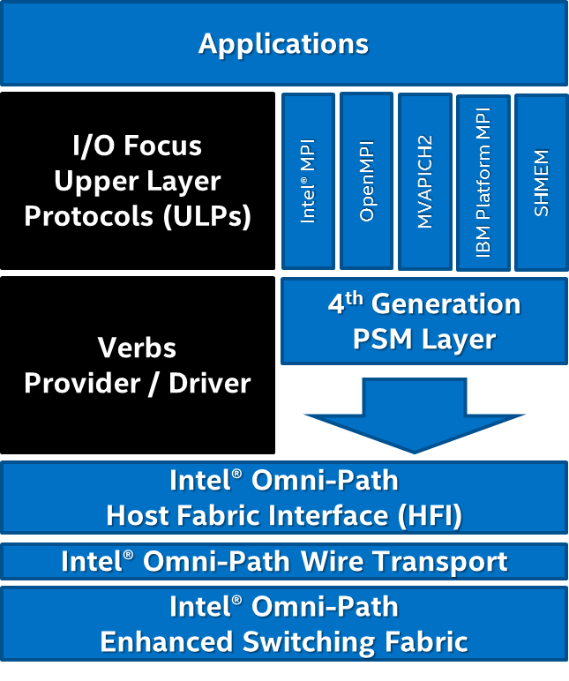
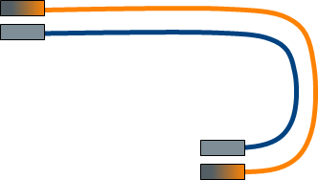
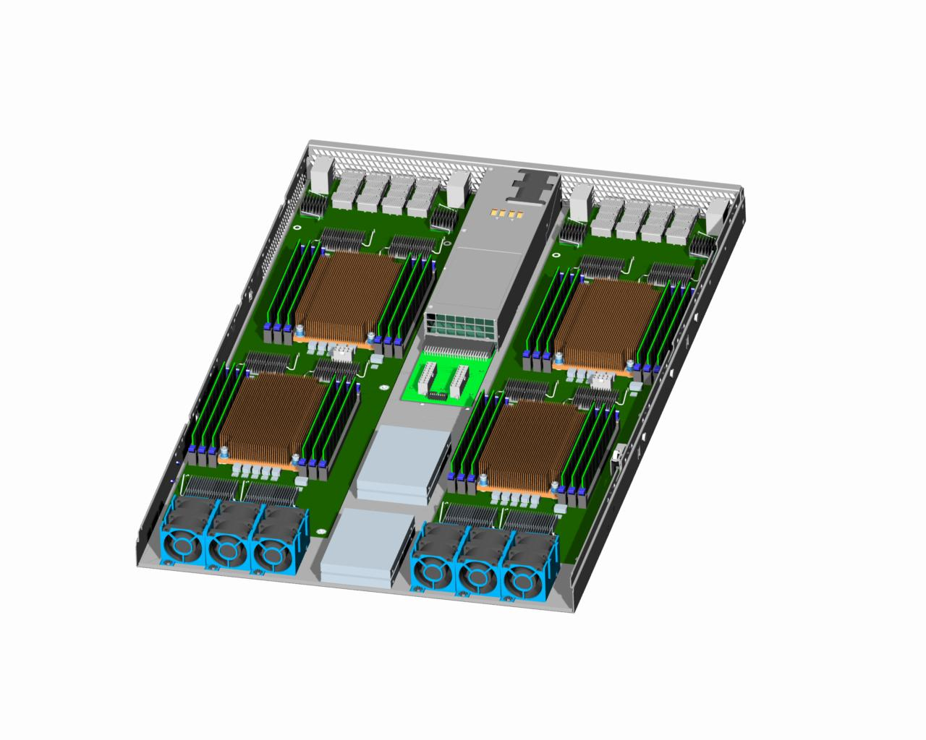



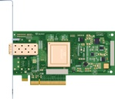
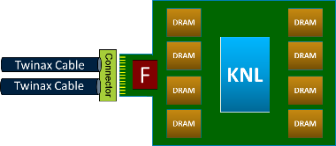

Intel® Omni-Path Architecture Product Portfolio
Host Fabric Interface (HFI)
Switch
Software
Cables
HFI
ASIC
Switch
ASIC
Intel® Fabric Suite
[based on OFA with Intel® Omni-Path Architecture support]
Passive Copper & Active Optical Cable (AOC)
“Wolf River” (HFI) Silicon
2 x 100 Gbps, 50 GB/sec Fabric Bandwidth
“Prairie River” Switch Silicon
48 ports, 9.6Tb/s, 1200 GB/sec Fabric Bandwidth
Product Line
Passive Cu
Cable
AOC*
Custom Mezz
& PCIe Cards
Standard
PCIe Board¹
[code name
Chippewa Forest]
Intel® Xeon® processor and
Intel® Xeon Phi™ coprocessor
with integrated
Host Fabric
Interface (HFI)
Intel® Omni-Path
Edge Switch¹
[code name
Eldorado Forest]
Intel® Omni-Path
Director Class Switch¹
[code name
Sawtooth Forest]
Custom
Switches
  1 Will be available as both a reference design and Intel-branded product

Slide 42
Intel® Omni-Path Architecture:
48-Port Switch ASIC Benefits
SWITCH CHIP REDUCTION¹
LATENCY REDUCTION
Cluster Size | 36-port Switch ASIC | 48-port Switch ASIC | Intel® Omni-Path ADVANTAGE | 36-port Switch ASIC² | 48-port Switch ASIC³ | Intel® Omni-Path ADVANTAGE
64 nodes | 6 | 5 | 17% | 390ns | 330ns | 15%
256 nodes | 24 | 17 | 29% | 390ns | 330ns | 15%
512 nodes | 47 | 34 | 28% | 500ns | 330ns | 34%
1024 nodes | 151 | 67 | 56% | 760ns | 330ns | 56%
2048 nodes | 336 | 220 | 35% | 760 ns | 550ns | 27%
  Up to 56% fewer switch chips required
  Up to 55% lower latency
1 Based on a Full Bisectional Bandwidth (FBB) Fat-tree (CLOS) configuration
2 Latency numbers based on Mellanox CS7500 Director Switch and Mellanox SB7700/SB7790 Edge switch product briefs posted on www.Mellanox.com as of November 21, 2014.
3. Based on internal Intel simulations

Slide 43
New Intel Memory-Storage Hierarchy
Keeping data closer to compute→ better data-intensive app performance and energy efficiency
Today
Future
compute
compute
Processor
Caches
Caches
Enough Capacity to Support Local Application Storage
In-Package
High Bandwidth Memory
Local memory is now faster & in processor pkg
Compute Node
Local Memory
Non-Volatile Memory
Local Processing Node Temporal Storage
Higher Bandwidth . Lower Latency and Capacity
I/O Node storage moves to compute node
I/O Node
SSD Storage
Burst Buffer Storage
Faster Checkpointing
Quicker Recovery
Better App Performance
Some remote data moves onto I/O node
Remote Storage
Parallel File System (Hard Drive Storage)
Parallel File System (Hard Drive Storage)
Notes:
By moving the data closer to compute we’re also effectively changing the profile of the traditional pyramid shape to one that is more top heavy. We are moving the “center of data” (analogous to the concept of a shape’s center of mass) closer to compute.

Slide 44

ANL Selects Intel for World’s Biggest Supercomputer
2-system CORAL award extends IA leadership in extreme scale HPC
Aurora
Argonne National Laboratory
>180PF
April ‘15
Theta
Argonne National Laboratory
>8.5PF
Trinity
NNSA†
>40PF
July ’14
Cori
NERSC‡
>30PF
April ’14
+
>$200M
‡ Cray* XC* Series at National Energy Research Scientific Computing Center (NERSC).
† Cray XC Series at National Nuclear Security Administration (NNSA).
Notes:
Trinity PF >40PF per spec sheet at http://www.lanl.gov/projects/trinity/
CORI >30PF listed per ASCR Fact Sheet released by DOE coincident with Aurora announcement

Slide 45
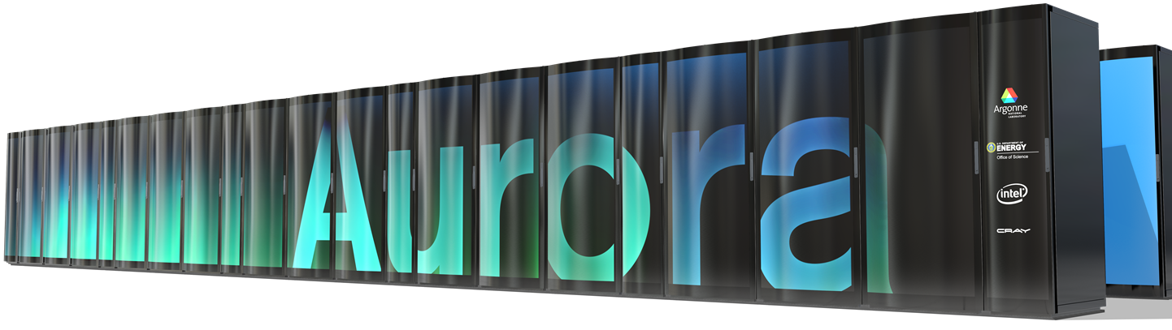



The Most Advanced Supercomputer Ever Built
An Intel-led collaboration with ANL and Cray to accelerate discovery & innovation
>180 PFLOPS
(option to increase up to 450 PF)
>50,000 nodes
13MW
2018 delivery
18X higher performance†
>6X more energy efficient†
Prime Contractor
Subcontractor
Source: Argonne National Laboratory and Intel.
†Comparison of theoretical peak double precision FLOPS and power consumption to ANL’s largest current system, MIRA (10PFs and 4.8MW)
Notes:
Aurora vs Mira comparisons (see Fact Sheet for more details)
>18X …….calculation → >180PF (Aurora) / 10PF (Mira) = >18X
>6X….(>180PF/13MW) / (10PF / 4.8MW) = >6.65X

Slide 46
Higher Performance & Density
A formula for more performance….
advancements in CPU architecture
 advancements in process technology
 integrated in-package memory
 integrated fabrics with higher speeds
 switch and CPU packaging under one roof
 all tied together with silicon photonics
= much higher performance & density

Slide 47
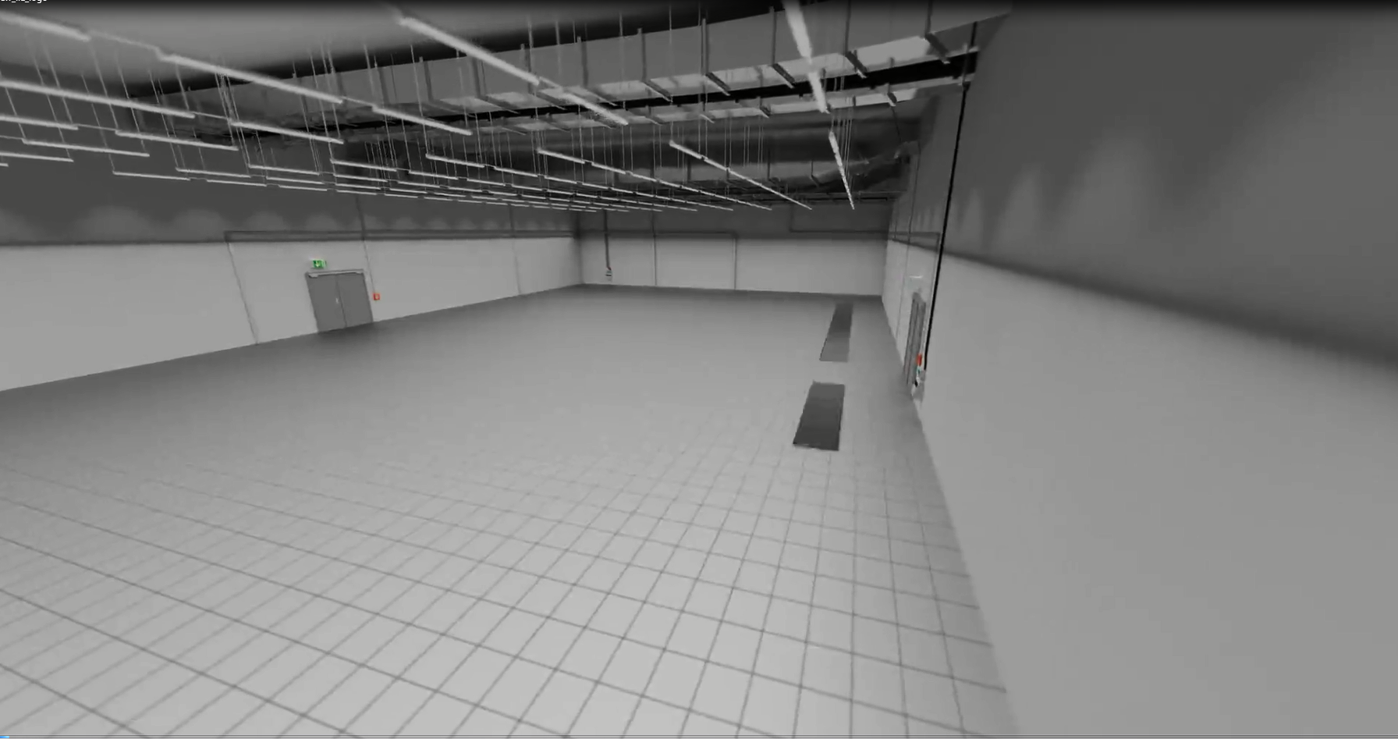
Designing for the future
What does “Large” mean?
A great example of reduced footprint with an equal performance:
Credit: Thanks to LRZ - Helmut Satzger for the video
https://www.youtube.com/watch?v=qirUUlXR6XQ
Notes:
https://www.youtube.com/watch?v=qirUUlXR6XQ

Slide 48
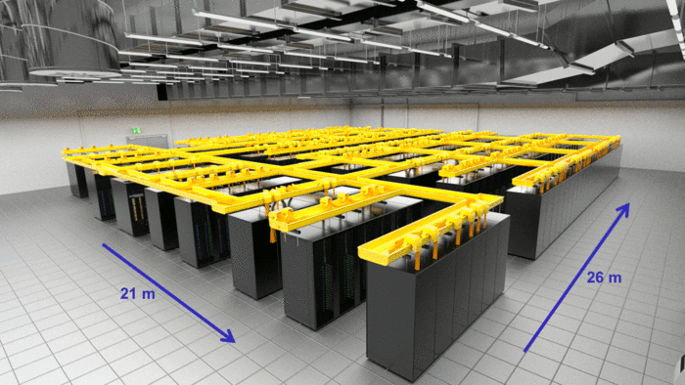
How many Sq mt Per PFlop?
System Feature | LRZ Phase 1 Details
Year | 2012
Performance Pflop/s | 3.2
# of Nodes | 9216
Power | 2.3 MW
Facility area for Compute Clusters | ~546 sq mt
How many Sq mt Per PFlop | 171
LRZ SuperMUC System
Source: lrz.de

Slide 49
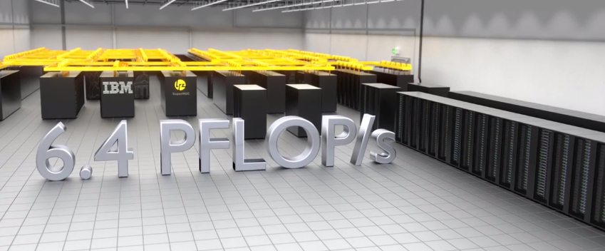
How many Sq mt Per PFlop?
System Feature | LRZ Phase 1 Details | LRZ Phase 2 Details
Year | 2012 | 2015
Performance Pflop/s | 3.2 | 3.2
# of Nodes | 9216 | 3096
Power | 2.3 MW | 1.1 MW
Facility area for Compute Clusters | ~546 sq mt | ~182 sq mt (*Estimated)
How many Sq mt Per PFlop | 171 | 57
LRZ SuperMUC System
Phase 1
Phase 2
Source: lrz.de

Slide 50

How many Sq mt Per PFlop?
System Feature | LRZ Phase 1 Details | LRZ Phase 2 Details | Trinity Details
Year | 2012 | 2015 | FY 2015/16
Performance Pflop/S | 3.2 | 3.2 | 42.2
# of Nodes | 9216 | 3096 | >19,000 (HSW, KNL)
Power | 2.3 MW | 1.1 MW | < 10 MW
Facility area for Compute Clusters | 546 sq mt | ~182 sq mt (*Estimated) | < 483 sq mt
How many Sq mt Per PFlop | 171 | 57 | 11.4
LRZ SuperMUC System
Phase 1
Phase 2
Source: lrz.de trinity.lanl.gov

Slide 51
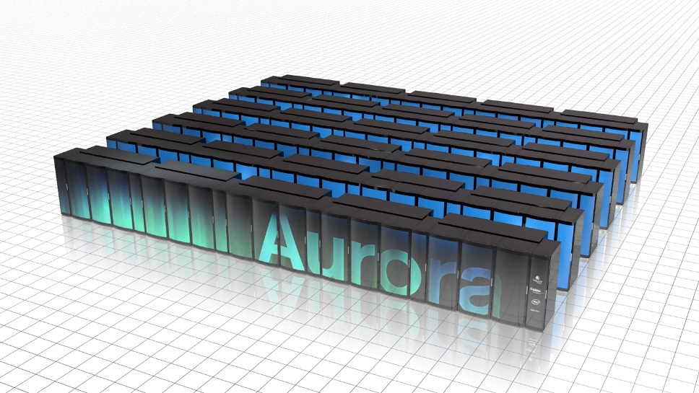
How many Sq mt Per PFlop?
Past
2015/16
Future
System Feature | LRZ Phase 1 Details | LRZ Phase 2 Details | Trinity Details | Aurora Details
Year | 2012 | 2015 | FY 2015/16 | 2018
Performance Pflop/S | 3.2 | 3.2 | 42.2 | 180
# of Nodes | 9216 | 3096 (HSW) | >19,000 (HSW, KNL) | >50,000 KNH
Power | 2.3 MW | 1.1 MW | < 10 MW | 13 MW
Facility area for Compute Clusters | ~546 sq mt | ~182 sq mt (*Estimated) | < 483 sq mt | ~279 sq mt
How many Sq mt Per PFlop | 171 | 57 | 11.4 | 1.5
LRZ SuperMUC System
Phase 1
Phase 2
Note: not an official Intel projection
Source: lrz.de

Slide 52
Significant improvement in Power efficiency
Past
2015/16
Future
System Feature | LRZ Phase 1 Details | LRZ Phase 2 Details | Trinity Details | Aurora Details
Year | 2012 | 2015 | FY 2015/16 | 2018
Performance -Pflop/s | 3.2 | 3.2 | 42.2 | 180
# of Nodes | 9216 | 3096 | >19,000 (HSW,KNL) | >50,000
Power | 2.3 MW | 1.1 MW | < 10 MW | 13 MW
System Power Efficiency (GFlops/Watt) | 1.4 | 2.9 | 4.2 | 13.8
LRZ SuperMUC System
Phase 1
Phase 2
Note: not an official Intel projection
Source: lrz.de

Slide 53
High Density Data center - Challenges
Performance density
  PF / rack – smaller HPC floor space
Weight density
  500 lbs/sf ~ 2500 kg/m2 – Likely needed
Power density
  >100 kW / rack fed with 480Vac or 400Vdc feeds
Pipe size
  ~40 mm to/from each rack
Ratios – Raised Floor vs Infrastructure Space
  m2/m2 < 1

Slide 54
SUMMARY
Trends
  Continuous growth in Cores & Threads
  Continuous & significant improvement in Power Efficiency
  More Integration to improve performance and efficiency
Designing for the future
  It’s going to be Large! kg/rack, kW/rack, perf/rack, power ramps and peak, pipe sizes, m2/m2
  It may get Smaller! Cluster footprint

Slide 55
Q & A

Slide 56
Legal Disclaimer
Intel may make changes to specifications and product descriptions at any time, without notice. Designers must not rely on the absence or characteristics of any features or instructions marked "reserved" or "undefined". Intel reserves these for future definition and shall have no responsibility whatsoever for conflicts or incompatibilities arising from future changes to them. The information here is subject to change without notice. Do not finalize a design with this information.
The products described in this document may contain design defects or errors known as errata which may cause the product to deviate from published specifications. Current characterized errata are available on request.
Contact your local Intel sales office or your distributor to obtain the latest specifications and before placing your product order.
Copies of documents which have an order number and are referenced in this document, or other Intel literature, may be obtained by calling 1-800-548-4725, or go to: http://www.intel.com/design/literature.htm
Intel, Intel Xeon, Intel Xeon Phi™, Intel® Atom™ are trademarks or registered trademarks of Intel Corporation or its subsidiaries in the United States or other countries.
Copyright © 2014, Intel Corporation
*Other brands and names may be claimed as the property of others.
Intel does not control or audit the design or implementation of third party benchmark data or Web sites referenced in this document. Intel encourages all of its customers to visit the referenced Web sites or others where similar performance benchmark data are reported and confirm whether the referenced benchmark data are accurate and reflect performance of systems available for purchase.The cost reduction scenarios described in this document are intended to enable you to get a better understanding of how the purchase of a given Intel product, combined with a number of situation-specific variables, might affect your future cost and savings. Nothing in this document should be interpreted as either a promise of or contract for a given level of costs.
Intel® Advanced Vector Extensions (Intel® AVX)* are designed to achieve higher throughput to certain integer and floating point operations. Due to varying processor power characteristics, utilizing AVX instructions may cause a) some parts to operate at less than the rated frequency and b) some parts with Intel® Turbo Boost Technology 2.0 to not achieve any or maximum turbo frequencies. Performance varies depending on hardware, software, and system configuration and you should consult your system manufacturer for more information.
*Intel® Advanced Vector Extensions refers to Intel® AVX, Intel® AVX2 or Intel® AVX-512. For more information on Intel® Turbo Boost Technology 2.0, visit http://www.intel.com/go/turbo
All products, computer systems, dates and figures specified are preliminary based on current expectations, and are subject to change without notice.
Optimization Notice Intel’s compilers may or may not optimize to the same degree for non-Intel microprocessors for optimizations that are not unique to Intel microprocessors. These optimizations include SSE2®, SSE3, and SSSE3 instruction sets and other optimizations. Intel does not guarantee the availability, functionality, or effectiveness of any optimization on microprocessors not manufactured by Intel. Microprocessor-dependent optimizations in this product are intended for use with Intel microprocessors. Certain optimizations not specific to Intel microarchitecture are reserved for Intel microprocessors. Please refer to the applicable product User and Reference Guides for more information regarding the specific instruction sets covered by this notice. Notice revision #20110804

Slide 57
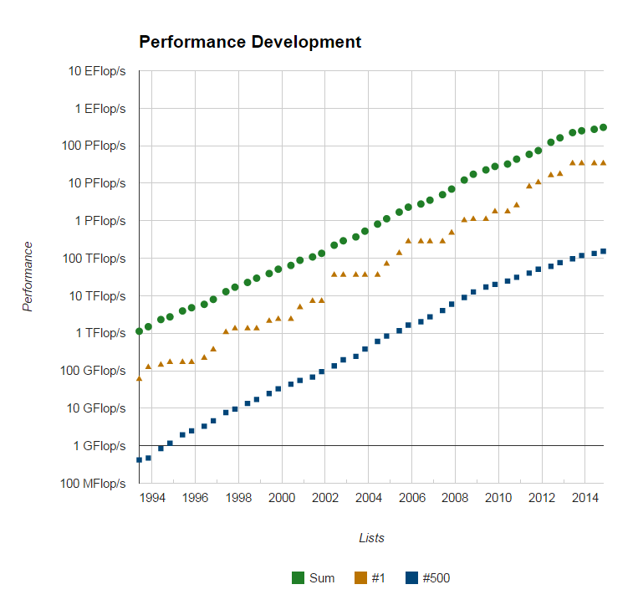
Exponential Growth in Performance
Advancement in key areas to reach Exascale:
  Microprocessors
  Fabrics
  Memory
  Software
  Power Management
  Reliability
  Density
Source:Top500.org

Slide 58
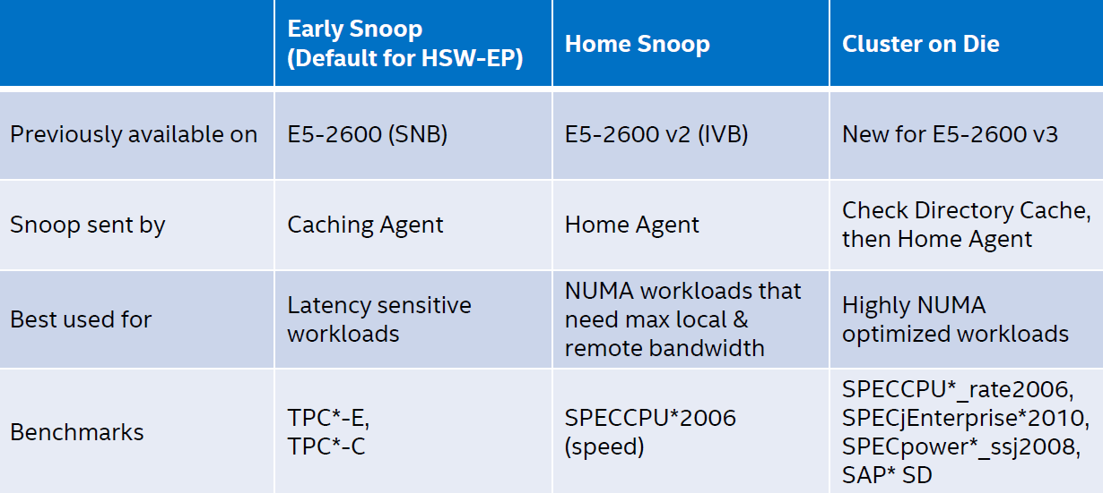
Snoop Models Supported in 2S Configurations

Slide 59
AVX** Disclaimer
  Intel® Advanced Vector Extensions (Intel® AVX)* are designed to achieve higher throughput for certain integer and floating point operations. Due to varying processor power characteristics, utilizing AVX instructions may cause
  some parts to operate at less than the rated frequency and
  some parts with Intel® Turbo Boost Technology 2.0 to not achieve any or maximum turbo frequencies.
  Performance varies depending on hardware, software, and system configuration and you should consult your system manufacturer for more information.
  **Intel® Advanced Vector Extensions refers to Intel® AVX, Intel® AVX2 or Intel® AVX-512. For more information on Intel® Turbo Boost Technology 2.0, visit http://www.intel.com/go/turbo
The above disclaimer will accompany all the CPU product documentation that support AVX.

Slide 60
Intel® Turbo Boost Technology Disclaimer
Requires a system with Intel® Turbo Boost Technology. Intel Turbo Boost Technology and Intel Turbo Boost Technology 2.0 are only available on select Intel® processors. Consult your system manufacturer. Performance varies depending on hardware, software, and system configuration. For more information, visit http://www.intel.com/go/turbo
The above disclaimer will accompany all the CPU product documentation that support Turbo Boost.

Slide 61
AVX** Frequency - Executive Summary
The Intel® Xeon® E5 v3 processor family (Haswell) now include the addition of AVX2 instructions which provides significant performance improvement as compared to non-AVX workloads
When executing Intel® AVX** instructions, the processor may run at less than rated frequency. To provide more information on frequencies, separate frequency specifications will be used:
  Marked/TDP (non-AVX) frequency and turbo
  AVX base frequency and turbo
Performance when using AVX instructions is significantly greater than non-AVX instructions even when the processor is operating at a slightly lower frequency
Intel® Turbo Boost Technology continues to provide opportunistic frequency increases based on workload, number of active cores, temperature, power and current
**Intel® AVX refers to Intel® AVX, Intel® AVX2 or Intel® AVX-512

Slide 62
Intel® Turbo Boost Technology 2.0 and Intel® AVX*
  Amount of turbo frequency achieved depends on:
    Type of workload, number of active cores, estimated current & power consumption, and processor temperature
  Due to workload dependency, separate AVX base & turbo frequencies will be defined for Xeon® processors starting with E5 v3 product family
 |  | AVX/Rated Turbo |  |  |  | Rated Turbo
 |  |  |  |  |  |  |  | AVX Turbo
Frequency | AVX/Rated Base |  |  |  | Rated Base
 |  |  |  |  |  |  | AVX Base
 | Previous Generations |  |  |  | E5 v3 & Future Generations
Additional Resources:
Whitepaper - Optimize Performance with Intel AVX
Intel® Xeon® Turbo Boost Opportunistic Frequency Upside
Using Intel AVX to Achieve Maximum Performance on Intel Xeon Processors
*Intel® AVX refers to Intel® AVX, Intel® AVX2 or Intel® AVX-512
Notes:
Common misconceptions:
Max all core turbo frequency is achieved consistently across all workloads
Turbo is opportunistic
Lower frequency = lower performance
AVX workloads may run at lower frequencies, but performance is still better than running without AVX & at a higher frequency

Slide 63
Haswell-EP Frequencies
GHz
3.2
3.1
3.0
2.9
2.8
2.7
2.6
2.5
2.4
2.3
2.2
2.0
TDP Turbo_{max}
AVX Turbo_{max}
649 GFLOPS peak
Example:
Intel® Xeon® E5-2697 v3
(14C, 2.6GHz, 145W TDP)
all cores active
Base Freq.
582 GFLOPS peak
Base AVX Freq.
492 GFLOPS peak
(DP-F.P.)
GHz

Slide 64
Hardware Configuration – Intel® Xeon® processor E5-2697 v3
 | Intel® Xeon® processor E5-2697 v2 | Intel® Xeon® processor E5-2697 v3
Platform | Intel® Server System R2208GZ4GC | Intel® Xeon® processor E5-2697 v3, Grantley platform
CPU | Intel® Xeon® processor E5-2697 v2 2.7 GHz , Dual socket 12 core, 8GT/s dual QPI links, 130 W, 3.5GHz Max Turbo Frequency 768kB instr L1 / 3072kB L2 / 30MB L3 cache | Intel® Xeon® processor E5-2697 v3 @ 2.60GHz / 9.6 GT/S, 145W, 14 core, Intel Smart Cache 35 MB
RAM | 64 GB total/node, 8*8GB 1600MHz Reg ECC DDR3 | 8x 8GB 2133 DDR4 DIMMs
Hard drive | SEAGATE* ST9600205SS (scsi), 1x600 GB SAS HDD 10kRPM | SSDSA2B220, 200GB, Intel® SSD DC S3500 Series 800GB
Intel® Xeon Phi™ Coprocessor | ECC Mode: Enabled; Coprocessor Stepping: C0, Board SKU: C0PRQ-7120 P/A/X/D, Frequency: 1.24GHz and Coprocessor Stepping: B1, Turbo On/Off documented within measurements, SKU used documented within measurements | ECC Mode: Enabled; Coprocessor Stepping: C0, Board SKU: C0PRQ-7120 P/A/X/D, Frequency: 1.24GHz and Coprocessor Stepping: B1, Turbo On/Off documented within measurements, SKU used documented within measurements
Cluster File System Abstract | Panasas (60 TB storage), IEEL Lustre DDN (49 TB storage), IEEL Lustre SSD (32 TB storage), Firmware version 5.5.0.b-1067797.15 | Panasas (60 TB storage), IEEL Lustre DDN (49 TB storage), IEEL Lustre SSD (32 TB storage), Firmware version 5.5.0.b-1067797.15
OS / Kernel / IB stack | Red Hat Enterprise Linux Server* release 6.5 / 2.6.32-358.6.2.el6.x86_64.crt1 / OFED 3.5-2-MIC-rc1 | Red Hat Enterprise Linux Server* release 6.5 / 2.6.32-358.6.2.el6.x86_64.crt1 / OFED 3.5-2-MIC-rc1,IFS-7.2.2.0.8
* Other names and brands may be claimed as the property of others.

